Slide 1

e4 higher Educational tools for an Embodied & creative Education on Energy
Project number: 2021-1-IT02-KA220-HED-000032259
Battle for energy – Krzysztof Rochowicz

Slide 2
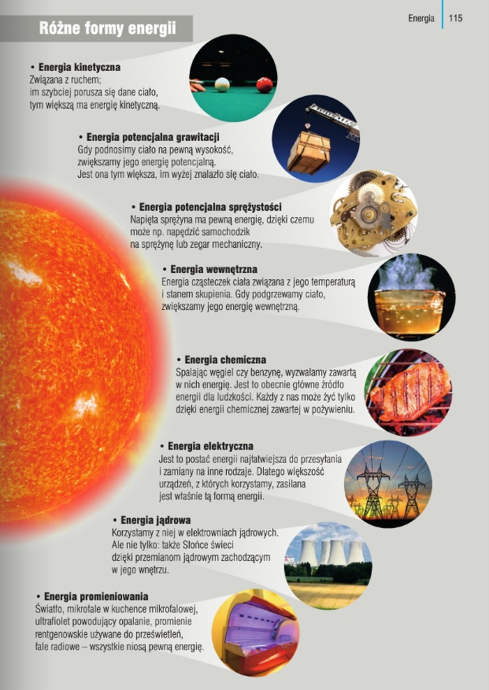
Example from the teztbook
„To jest fizyka” ed. Nowa Era
Mechanical energy
Energy - the ability to do work;
- the unit is the joule;
- the principle of conservation of energy: it does not appear out of nowhere and does not disappear, it can change form

Slide 3
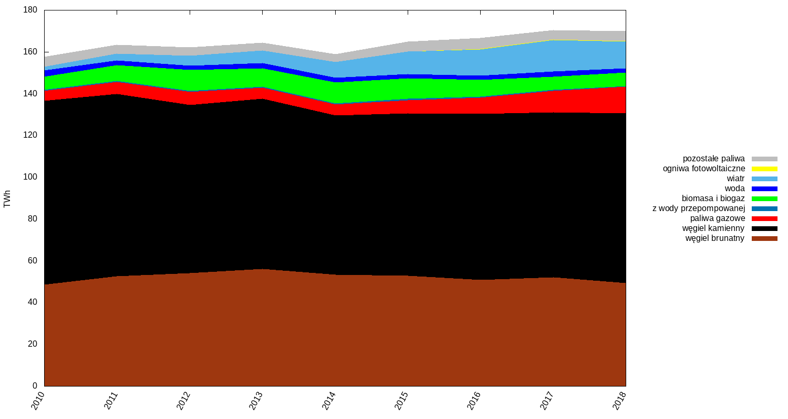
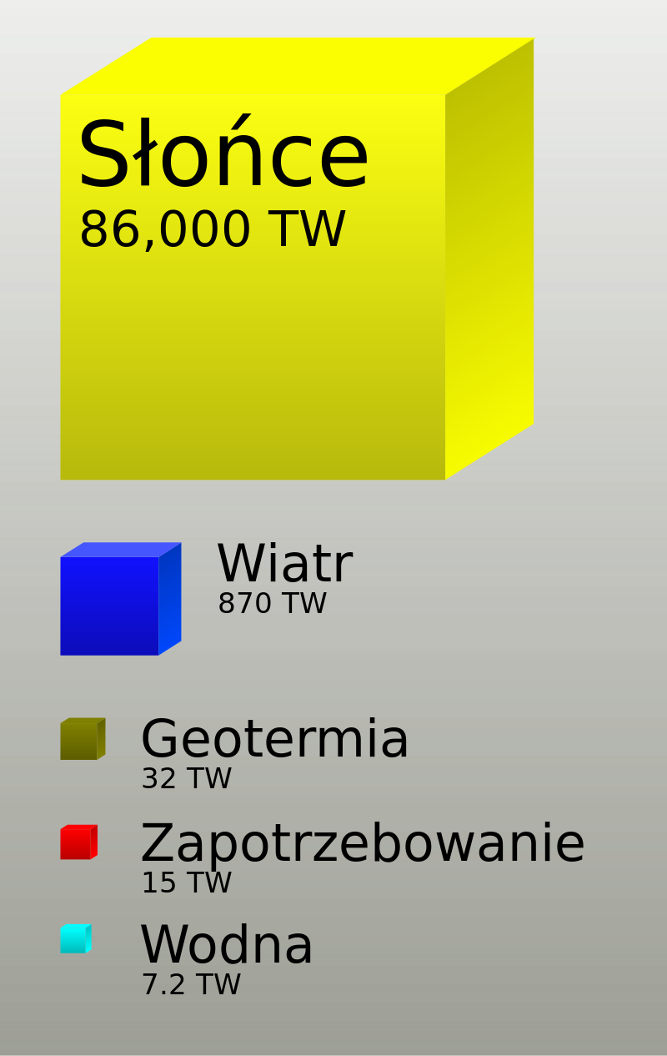
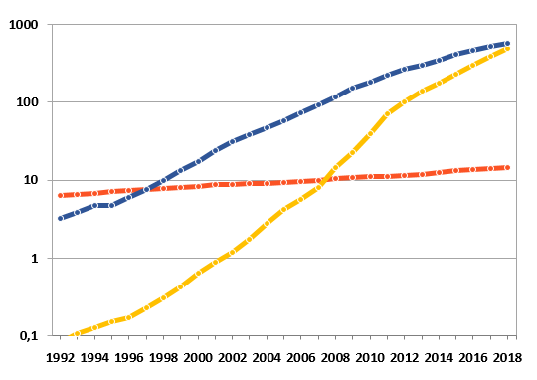
Renewable energy sources in the world and in Poland
Capacity (in GW) of wind (blue), solar (yellow) and geothermal (red) wind farms in the world in 1992–2018. Logarithmic scale.

Slide 4
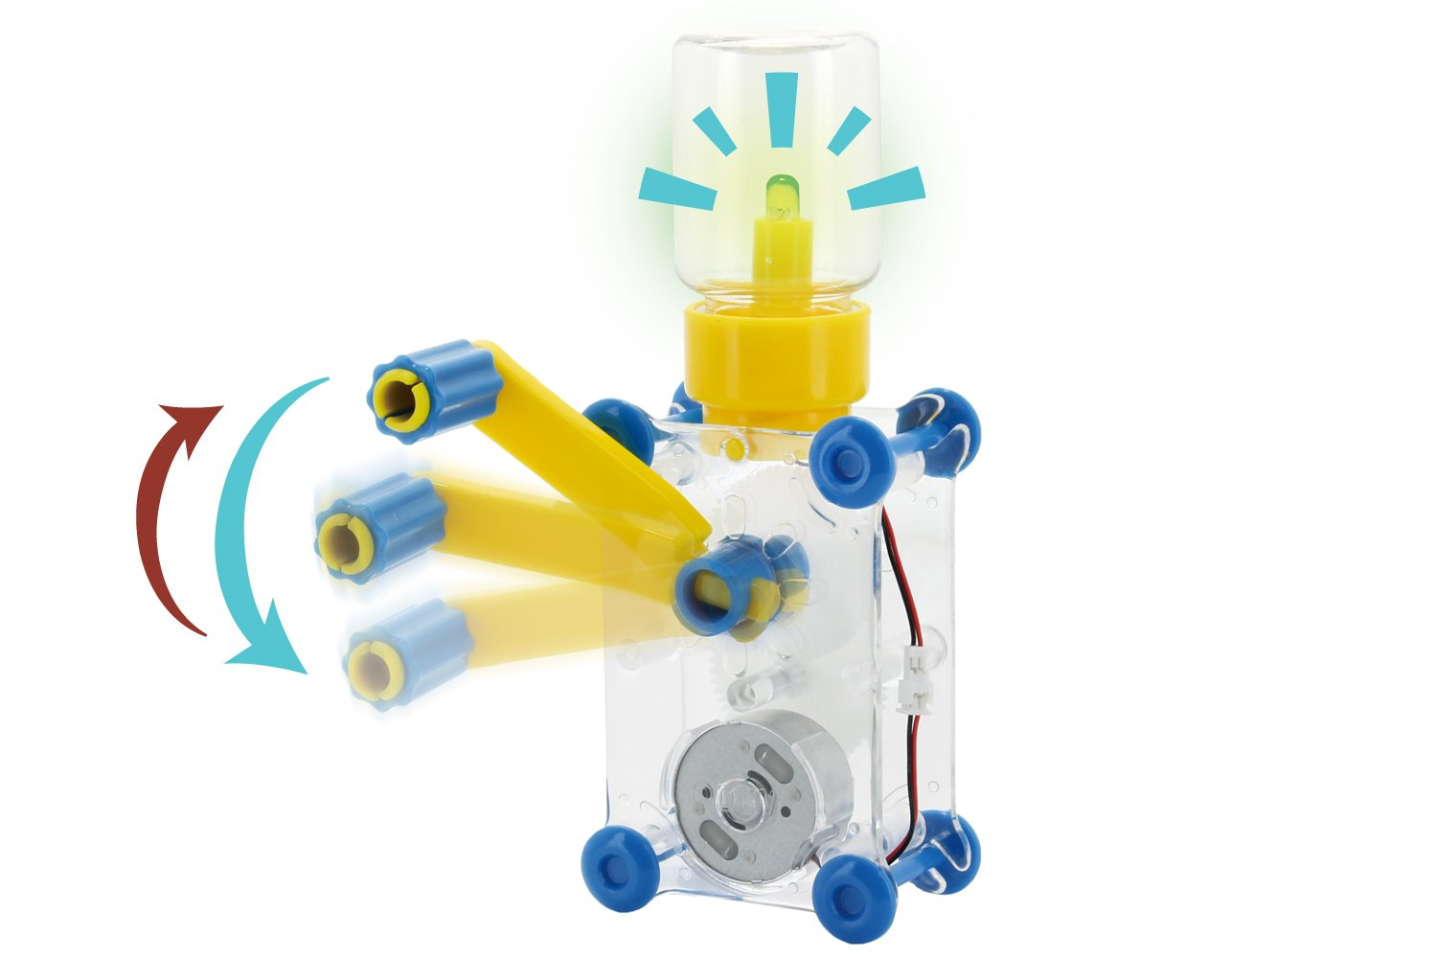
Where do we get electricity?

Slide 5
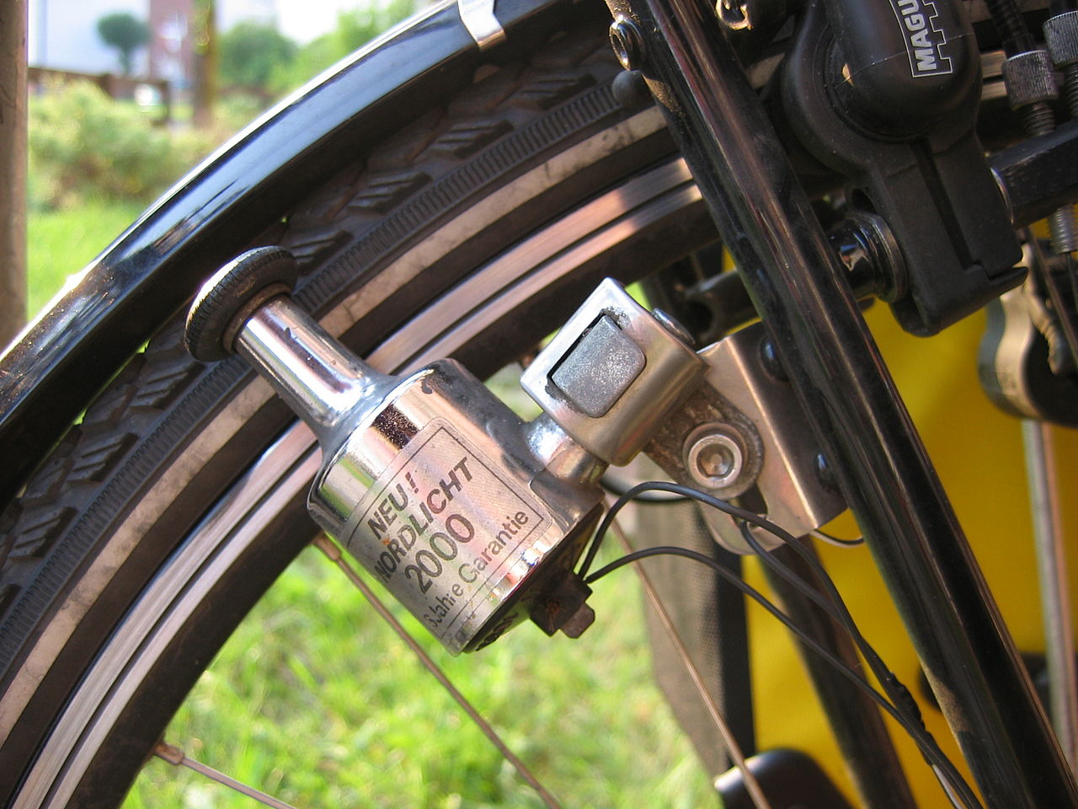
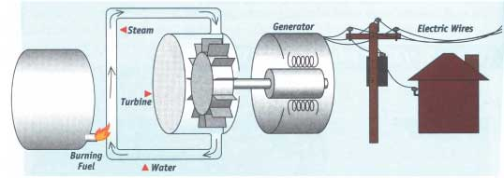
From dynamo to power station...

Slide 6
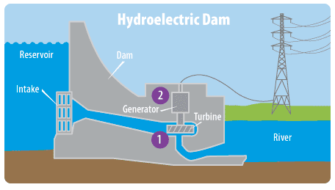
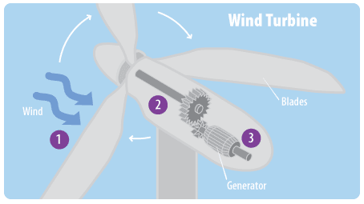
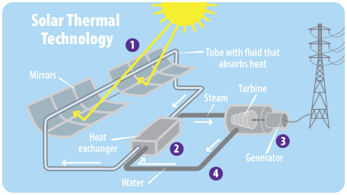
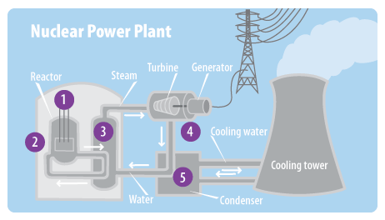
Various power plants

Slide 7
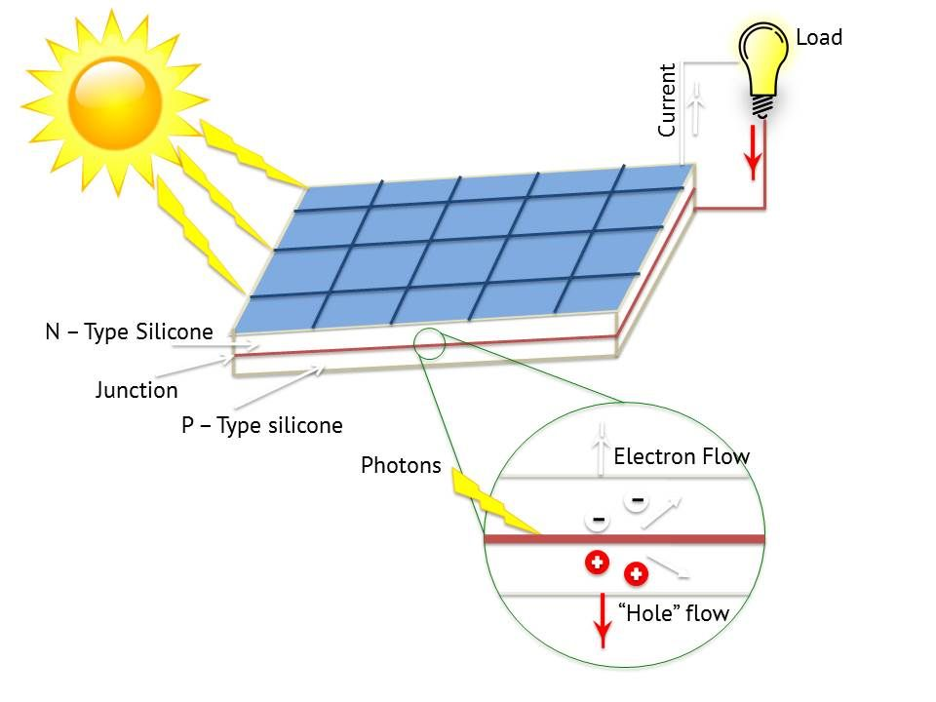
Energy from the Sun – photoelectric effect (Einstein, 1905)

Slide 8

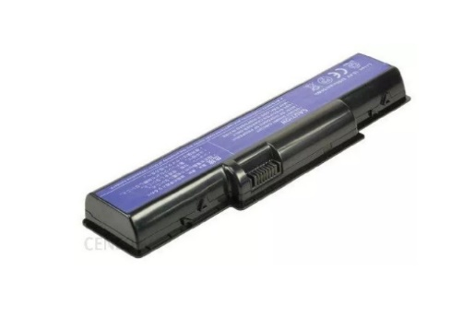
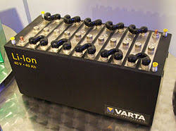
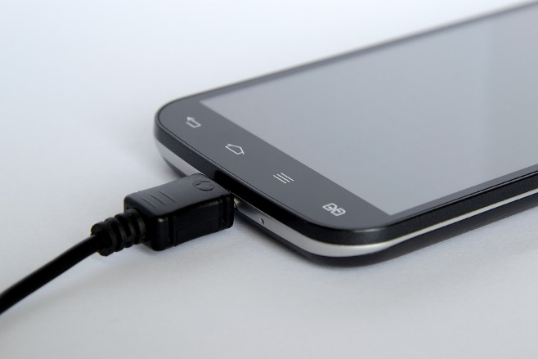

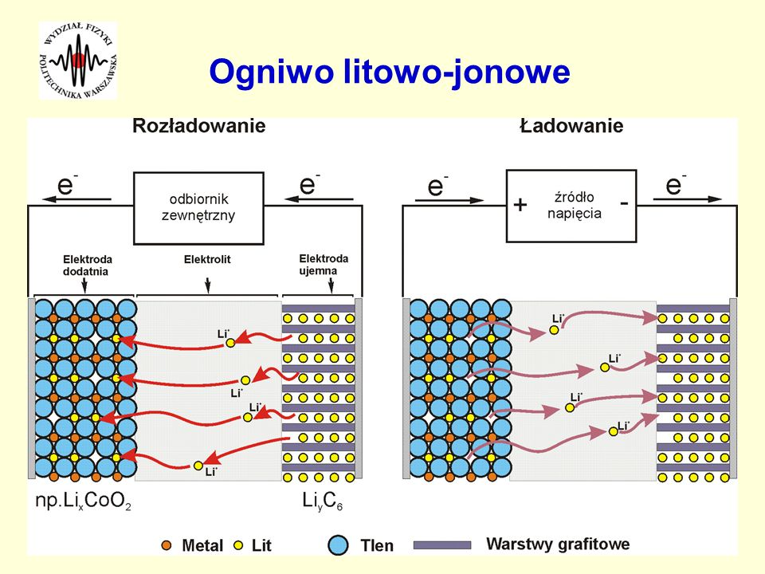
Electricity for everyone

Slide 9
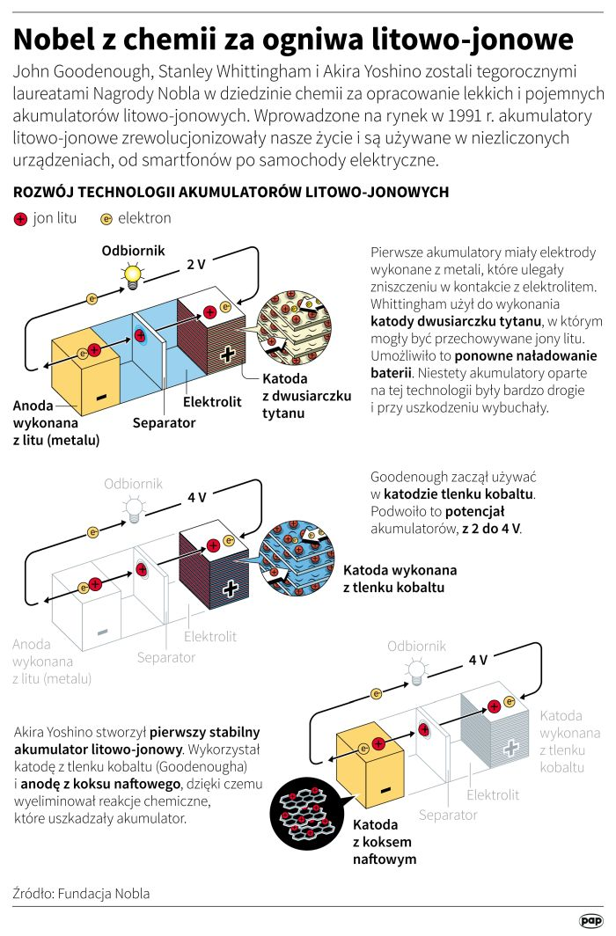


Slide 10
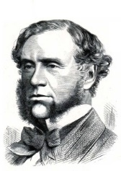
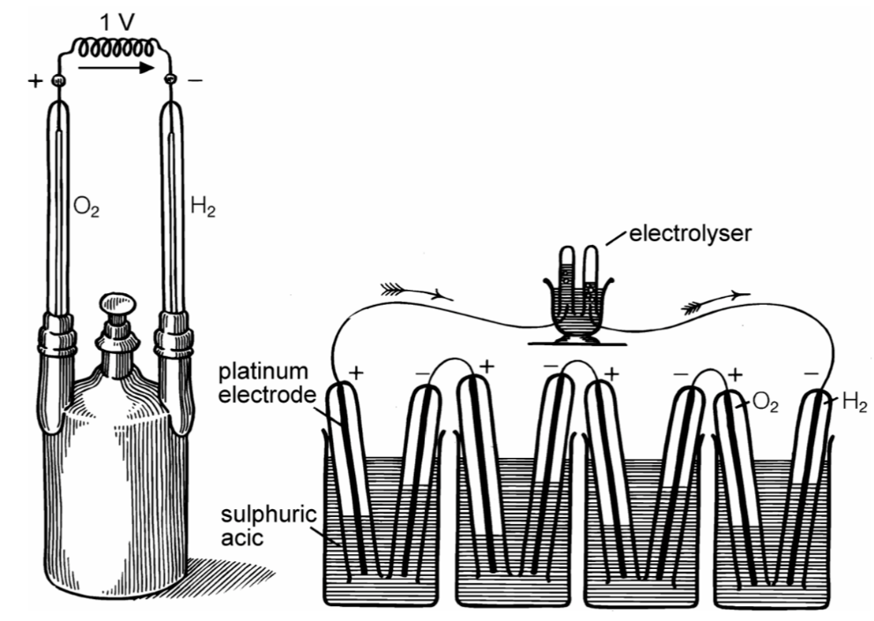
„Gas battery“- the first fuel cell
British lawyer (and amateur scientist) developed the first fuel cell in 1839. The principle was discovered by chance during an electrolysis experiment. When Grove disconnected the battery from the electrolyser and put the two electrodes together, he noticed a current flowing in the opposite direction, consuming the gases of hydrogen and oxygen. His gas battery consisted of platinum electrodes placed in hydrogen and oxygen tubes immersed in a bath of dilute sulfuric acid. It generated about one volt.
In 1842, Grove connected several gas batteries in series to form a "gas chain". He used electricity generated from the gas chain to power the electrolyser, dividing the water into H and O. However, due to problems with electrode corrosion and material instability, the Grove cell was not practical. As a result, there was little research into fuel cell development for many years until the mid-20th century.
Sir William Grove
https://pl.wikipedia.org/wiki/William_Grove#/media/Plik:William_Robert_Grove.jpg
Grove’s ‘gas battery’ (1839) produced a voltage of about 1 volt, shown left. Grove’s ‘gas chain’ powering an electrolyzer (1842), shown right.

Slide 11
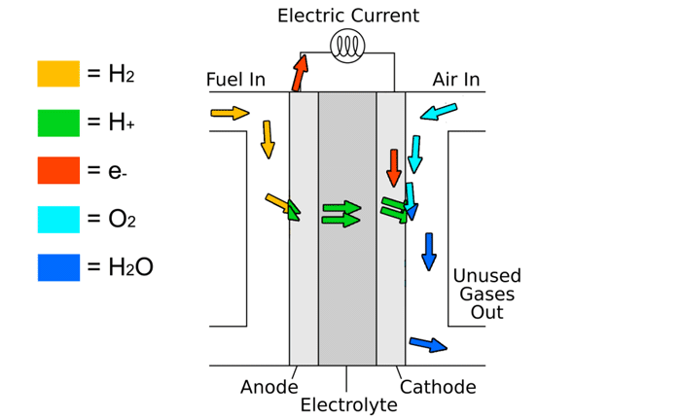
Modern fuel cell

