Slide 1
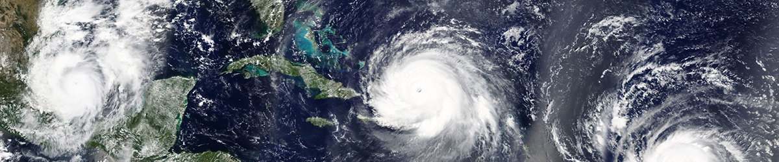
University of Trento
Master of Science in Environmental Meteorology https://international.unitn.it/environmental-meteorology
A.A. 2023-24
Environmental Physical Chemistry
Inorganic species and oxidation processes in atmosphere
Daniela Ascenzi
Dept. Physics, University of Trento, Italy
e-mail: daniela.ascenzi@unitn.it
Notes:
To improve the parts on Oxidation in the Troposphere see:
See http://butane.chem.uiuc.edu/pshapley/environmental/L14/index.html

Slide 2
Inorganic species in the atmosphere
CO₂ is the second most abundant inorganic compound (after H₂O)
  natural constituent of the atmosphere
  greenhouse gas
Oxides of C (CO), S and N are important inorganic air pollutants
  SO₂, SO₃
  N₂O, NO, NO₂, ...
  cause pollutant acid precipitations
Other inorganic pollutants include:
  NH₃ (ammonia)
  HCl (hydrochloric acid)
  H₂S (sulphidric acid)

Slide 3
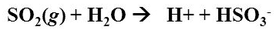
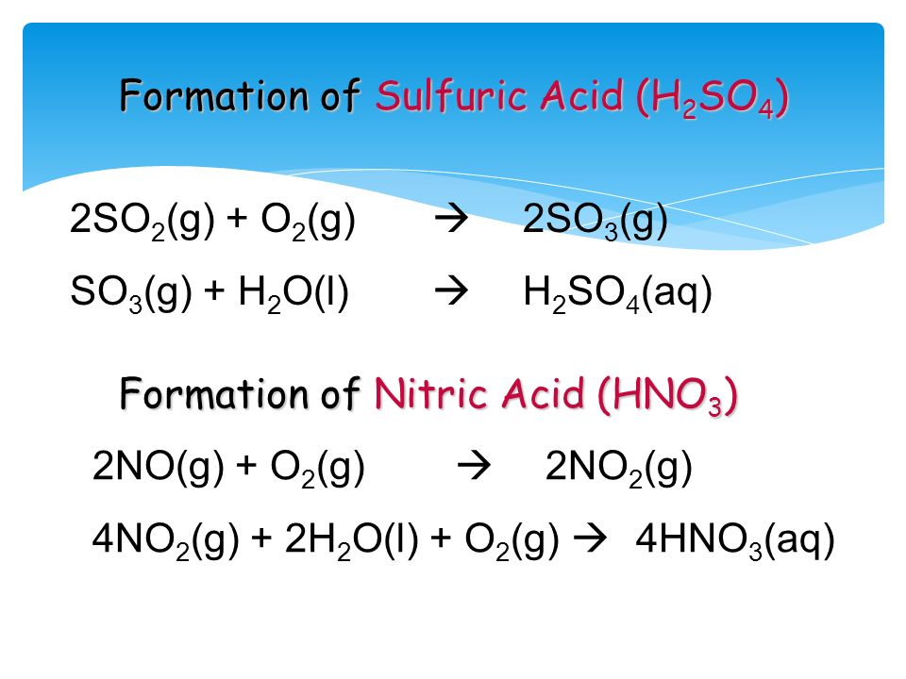
Acid-base reactions in the atmosphere
ACIDS
Rainwater is naturally slightly acidic due to the presence of dissolved CO₂:
Stronger acids can be formed from other acid gases, e.g. SO₂, SO₃, NO₂:
Strong pollutant acids (acid rains) are:
H₂SO₄, HNO₃, HCl
Notes:
Further details on the chemistry of CO2 in water can be found here, for those who are not familiar with chemistry
http://butane.chem.uiuc.edu/pshapley/environmental/L25/index.html

Slide 4
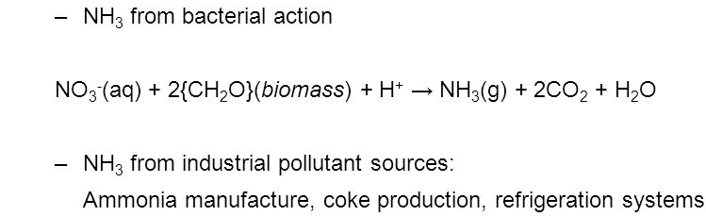
Acid-base reactions in the atmosphere
BASES
Usually from ash and ground rocks: CaO, Ca(OH)₂, CaCO₃
NH₃ (ammonia) is the most important base in atmosphere (and the only one in gas phase)
(e.g. enzimatic decomposition of urea in animal urine)
Mineralization of organic material
NH₃ reacts with acids to produce salts (corrosives):
NH_{3(aq)} + HNO_{3(aq)} →NH₄NO_{3 (aq)}
Production of nitrate aerosols is one of the few mechanisms by which NO_{x} are removed from atmosphere
NH_{3(aq)} + H₂SO_{4(aq)} →(NH₄)₂SO_{4 (aq)}
Notes:
Main sources of NH3 is biological activity (decomposition of urea in animal urine by enzymes, the decomposition of excrement and the release from soils and the ocean following mineralization of organic material
Anthropogenic sources : centre around its use in fertilizers and as a byproduct of waste production.
Ammonia has a short lifetime in the atmosphere of approximately 10 days and is removed mainly by both wet and dry deposition processes, with some
additional loss via reaction with OH radicals.
Since deposition processes dominate its loss and sources are diverse, levels of ammonia are highly variable, ranging from 0.1 to 10 ppbv over continental regions. It has already been noted that ammonia is the only alkaline
gas in the atmosphere and forms ammonium sulphate aerosols. Deposition of ammonium sulphate to the soil decreases its pH, leading to a decline in growth.
See also Chapt. 4 Hewitt Jackson for biogeochemical cycles

Slide 5
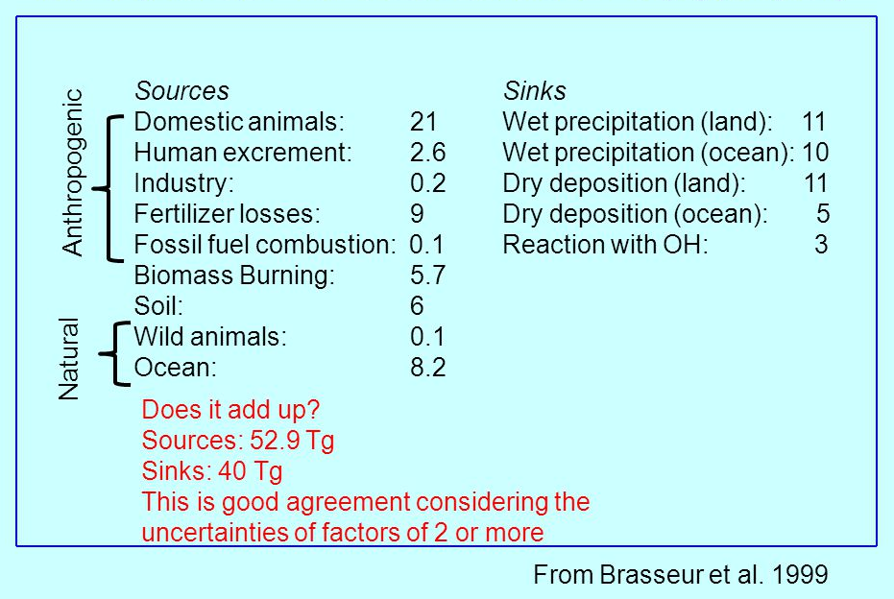
NH₃ sources and sinks in atmosphere
In Tg/year (Tg =10¹² g)
Notes:
See also Chapt. 4 Hewitt Jackson for biogeochemical cycles
Ammonia has a short lifetime in the atmosphere of approximately 10 days and is removed mainly by both wet and dry deposition processes, with some
additional loss via reaction with OH radicals. The main sources arise from biological activity, such as the decomposition of urea in animal urine by enzymes, the decomposition of excrement and the release from soils and the ocean following mineralization of organic material. Anthropogenic sources centre around its use in fertilizers and as a byproduct of waste production. Since deposition processes dominate its loss and sources are diverse, levels of ammonia are highly variable, ranging from 0.1 to 10 ppbv over continental regions. It has already been noted that ammonia is the only alkaline gas in the atmosphere and forms ammonium
sulphate aerosols. Deposition of ammonium sulphate to the soil decreases its pH, leading to a decline in growth.

Slide 6
Nitrogen oxides in atmosphere
N₂: remarkable strenght of the triple bond ⇒ N₂ is chemically and photochemically stable
However:
N₂ can react with O₂ under high T of combustion engines
(or naturally in lightning)
2. NH₃ and volatiles amines can be oxidized in atmosphere
Formation of nitrogen oxides NO_{x}:
NO, NO₂ , NO₃⋅
but also N₂O
Notes:
For N cycling in atmosphere
http://rstb.royalsocietypublishing.org/content/368/1621/20130115/F2
For N compounds in atmosphere
http://butane.chem.uiuc.edu/pshapley/environmental/l16/1.html

Slide 7
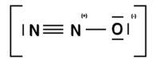

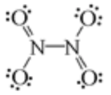
Nitrogen oxides in atmosphere
N₂O (nitrous oxide)
produced by bacteria (soil and oceans)
non-toxic (anesthetic gas, propellant for whipped cream in cans)
relatively unreactive in troposphere, main source of HNO₃ and nitrates in stratosphere (⇒ stratospheric O₃ chemistry)
NO (nitric oxide)
reactions of O₂ and N₂ (combustion engines, lightning strikes)
radical species ⇒ very reactive in the atmosphere
precursor of NO₂
NO₂ (nitrogen dioxide)
reactions of O₂ and N₂: combustion of fossil fuels and biomass
oxidative decomposition of NH₃/amines in atmosphere.
brown gas (color of photochemical smog)
radical species ⇒ very reactive in the atmosphere
is in equilibrium with its colorless dimer, N₂O₄
N₂O₄ (dinitrogen tetraoxide)
weak N-N bond, not a radical
reacts with H₂O ⇒ HNO₂ and HNO₃
Notes:
For N cycling in atmosphere
http://rstb.royalsocietypublishing.org/content/368/1621/20130115/F2
For N compounds in atmosphere
http://butane.chem.uiuc.edu/pshapley/environmental/l16/1.html

Slide 8
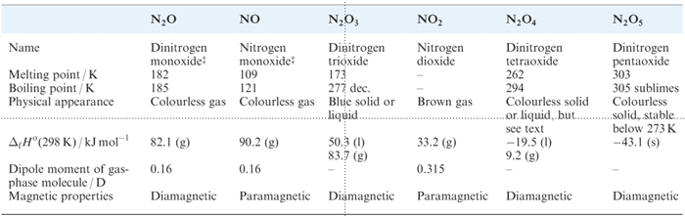
Nitrogen oxides in atmosphere
NO₃⋅ (nitrogen trioxide)
radical species (unpaired electron on one of the O atoms) ⇒ very reactive in the atmosphere
reactivity is similar to that of OH radical
NO_{x} are toxic to humans and other organisms
Important in the production of tropospheric O₃ and photochemical smog

Slide 9
NO_{x} production
N in combustions
N₂ (air is used in combustion mixture)
N as “impurity” in HC fuels
Production of thermal NO_{x} termico (radical mechanism)
O₂ → 2O⋅
1.
K_{eq}(T)
k₁
2.
N₂ + O⋅ → NO⋅ + N⋅
ΔH = +75.5 kcal/mol
O and N act as catalysts
k₋₁
endothermic with an activation energy. Is the “rate limiting step”
3.
O₂ + N⋅ → NO⋅ + O⋅
ΔH = -32.5 kcal/mol
N₂ + O₂ → 2NO⋅
ΔH = +43 kcal/mol
In addition to: OH⋅ + N⋅ → NO⋅ + H⋅ when OH is present
Reaction 2: strong dependence on T: more efficient at high T
At thermodynamic equilibrium NO production is disfavoured (ΔH>0 with ΔS~0)
Notes:
Produzione di NO termico: deriva dal fatto che sto facendo reazioni fortemente esotermiche (combustioni) in presenza di N2 visto che uso aria come comburente. La quantità di atomi di O dipende dalla T di combustione. Atomi di O fungono da catalizzatori quindi non ne servono molti, infatti il primo step non è determinante

Slide 10
Main oxidants in atmosphere
O₂: is the most abundant oxidant in atmosphere. O₂ in the ground state (³Σ_{g}) reacts very slowly with other species (spin-forbidden reactions)
O₃: is the second most abundant oxidant
The most efficient oxidants are radical species (very reactive due to the unpaired electron)
OH• hydroxyl radical
NO₃• nitrate radical
HOO• hydroperoxyl radical
Cl• atomic chlorine radical
Notes:
For a series of lessons on Oxidation in the Troposphere
See http://butane.chem.uiuc.edu/pshapley/environmental/L14/index.html

Slide 11
OH radical
Sources
1. Main source in remote areas:
At 50% R.H. and 300K ∼10% of the O(¹D) leads to OH
Requirements:
high levels of humidity
high solar irradiance
most prevalent in tropical regions
2. Additional sources in polluted environments:
PHOTOLYTIC sources
DAY-TIME oxidant
3. Under high NO concentrations:
Notes:
The OH radical is one of the most dominant oxidants in the troposphere. It is most prevalent in tropical regions where high levels of humidity and solar irradiance lead to high rates of OH production: O3 + hv(λ < 340 nm) → O2 + O( 1D) (R1) O( 1D) + H2O → 2 OH (R2)

Slide 12
OH radical
Reactivity
With HC (alkanes, aromatics, halocarbons) OH reacts by H atom abstraction
With unsaturated HC (alkenes, alkynes) OH reacts by insertion onto the double/triple bond
Notes:
The OH radical is one of the most dominant oxidants in the troposphere. It is most prevalent in tropical regions where high levels of humidity and solar irradiance lead to high rates of OH production: O3 + hv(λ < 340 nm) → O2 + O( 1D) (R1) O( 1D) + H2O → 2 OH (R2)

Slide 13
OH radical
Reactivity with organic species
larger HC react faster than CH₄
olefines react faster than HC (different mechanism)
Halocarbons (HCFC) react faster than CH₄ (presence of a dipole reduces C-H bond energy)
CFC do not react (or very slowly (due to the absence of H atoms)
See my previous lessons on chemical kinetics
Notes:
Reactivity with larger HC is faster than with CH4 (this is due to the fact that the H-C bond is easier to break when C is bonded to other C).
For hydrogenated halocarbons (CH3Cl) reactivity is even faster and to explain it we need to consider the effect of the C—Cl bond. We know that Cl is electronegative and will draw electron density away from C and leave the 3 H atoms with a slight positive charge. This induced dipole increases the reaction between the H and OH.

Slide 14
O₃ radical
Source: (troposphere)
NO₂ + hν (λ < 420 nm) → O(³P)+ NO
O(³P) + O₂ + M → O₃ + M
O₃ + NO → O₂ + NO₂
CO (or VOCs, CH₄, NMHC) in addition to NO_{x} are required for photochemical generation of O₃
Small concentrations also from natural VOC and NO_{x} emissions
O₃ is long-lived ⇒ transported downwind and survival into nigthtime hours
PHOTOLYTIC sources
DAY-TIME + NIGHT-TIME oxidant
Reactivity
Only mildly reactive with VOCs: it essentially reacts only with alkenes by addition reactions to the double bond
Notes:
We have already discussed this mechanism in previous lesson. I remind you of it here

Slide 15
NO₃ radical
Sources
Readily photolyzed by VIS light
PHOTOLYTIC destruction
NIGHT-TIME oxidant
Reaction
NO₃ is a source of HNO₃ by night. It is a chemical reservoir of NO_{x} that are liberated during daytime
NO₃ + HCHO → HCO+ HNO₃
Addition to double bonds generates nitrate-substituted peroxy radicals, some of which react/decompose to generate HO₂ radicals
Notes:
Night time oxidant NO3 is less reactive at H atom abstraction than the day counterpart OH. However the night time concentrations of NO3 under some conditions is much higher than those of OH during day (e.g. 400ppt vs 0.4 ppt) so NO3 can remove comparable amount of VOCs than OH, especially unsaturated ones since NO3 reacts more rapidly with olefins (CC double bonds) than with alkanes.
The addition of NO3 to double bonds generates nitrate-substituted peroxy radicals, some of which react/decompose to generate HO2 radicals

Slide 16
NO₃ radical
Oxidation properties
NO₃ is less reactive at H atom abstraction than the day counterpart OH.
However the night time concentrations of NO₃ under some conditions is much higher than those of OH during day (e.g. 400ppt vs 0.4 ppt) so NO₃ can remove comparable amount of VOCs than OH, especially unsaturated ones
NO₃ reacts more rapidly with olefins (CC double bonds) than with alkanes.
Notes:
Night time oxidant NO3 is less reactive at H atom abstraction than the day counterpart OH.
However the night time concentrations of NO3 under some conditions is much higher than those of OH during day (e.g. 400ppt vs 0.4 ppt) so NO3 can remove comparable amount of VOCs than OH, especially unsaturated ones
NO3 reacts more rapidly with olefins (CC double bonds) than with alkanes.
The addition of NO3 to double bonds generates nitrate-substituted peroxy radicals, some of which react/decompose to generate HO2 radicals

Slide 17
HOO radical
Sources
Any reactions that produce H or HCO in the troposphere act as HOO sources
Example1: formaldehyde (from partial oxidation of HC) is a major HOO source in the daytime:
Example2: alkoxy radical generated by VOC oxidation sequence
More generally: HOO is a natural consequence of the oxidation of organics
Notes:
Thus, formaldehyde photolysis is a major source of HO2 during the day:

Slide 18
HOO radical
Reactivity
Fairly unreactive with most organics. Reacts readily with aldehydes
Involved in tropospheric O₃ formation:
RCH₃ + OH• → RCH₂• + H₂O
RCH₂• + O₂ + M → RCH₂O₂• + M
RCH₂O₂• + NO → NO₂ + RCH₂O•
RCH₂O• + O₂ → RCHO + HOO•
HOO• + NO → NO₂ + OH•
NO₂ + hν → NO + O
O + O₂ + M → O₃ + M
--------------------------------
RCH₃ + 4O₂ + hν → 2O₃ + RCHO + H₂O NET reaction

Slide 19
Cl radical
Sources
In marine areas, NaCl particles (from wave generated droplets+water evaporation) can react to form Cl atoms:
N₂O_{5(g)} + NaCl_{(s/aerosol)} → ClNO_{2(g)} + NaNO_{3(s/aerosol)}
ClONO_{2(g)} + NaCl_{(s)} → Cl_{2(g)} + NaNO_{3(s)}
Followed by photodissociation reactions:
PHOTOLYTIC sources
DAY-TIME oxidant
but requires N₂O₅ that is produced at night
Reactivity
Atomic chlorine contributes to VOC oxidations in the marine boundary layer
Notes:
In marine areas, wave action generates airborne droplets of seawater from which the water can evaporate, leaving a suspended particle of the dissolved solids. Because this is mainly NaCl, the possibility exists for the generation of atomic chlorine via the reactions of NaCl with gaseous species such as N205 or ClONO2
For production of N2O5 see:
https://www.sciencedirect.com/science/article/pii/S1352231005006904
while there is evidence that atomic chlorine is generated from sea salt reactions and contributes to organic oxidations in the marine boundary layer, the
nature and strength of the sources remain to be elucidated.

Slide 20
N₂O₅ (dinitrogen pentoxide)
Sources
At night NOx (NO and NO₂) are oxidized by ozone:
(1) NO + O₃ → NO₂ + O₂
(2) NO₂ + O₃ → NO₃ + O₂
(3) NO₂ + NO₃ + M N₂O₅ + M
←
→
Reactivity
N₂O_{5(g)} + H₂O_{(l)} → 2HNO_{3(aerosol)}
on the surface or inside aerosol particles
nocturnal N₂O₅ is critical for NOx removal from the atmosphere
N₂O₅ is important as a reservoir of NO₃ as indicated in equilibrium (3)
Notes:
Due to the absence of sunlight OH radicals concentrations is almost zero. Instead, another oxidant, the nitrate radical, NO3, is generated at night by the reaction of NO2 with ozone. NO3 radicals further react with NO2 to establish a chemical equilibrium with N2O5.
Much of the atmospheric chemistry of N2O5 occurs on the surfaces of, or inside, aerosol particles. N2O5 is readily taken up by aqueous inorganic particles and water droplets, where it undergoes hydrolysis with liquid water to produce nitric acid. The latter is then often neutralised by the uptake of ammonia.

Slide 21
Atmospheric chemistry at night
From S. Ball, ECG Environmental Briefs n.3
Notes:
NO3 reacts rapidly with isoprene and terpenoid compounds emitted by plants, for which NO3 is often their dominant sink
The non-radical oxidation products of NO3 + VOC reactions are multi-functional organic nitrates containing alcohol, peroxide or carbonyl groups. These compounds have low vapour pressures and consequently partition onto atmospheric particles to generate secondary organic aerosol (SOA) which is an air pollutant.
Laboratory studies also suggest that NO3 radicals react directly with organic components in aerosol particles.

Slide 22
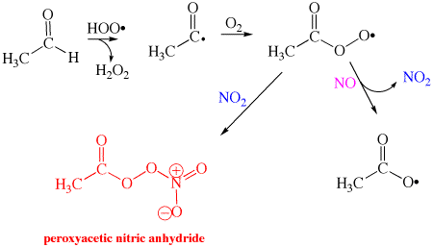
Reactions of NO and NO₂
NO reacts with organic peroxy radicals ROO• to give NO₂ and an alkoxy radical RO•
NO₂ add to peroxy radicals ROO• to give potentially harmful compounds (e.g. PAN from acetaldehydes CH₃COH)
PAN: very irritating, toxic to humans, animals an plants
PeroxyAcetyl Nitrate
Notes:
NO typically reacts with organic peroxy radicals to form NO₂ and an alkoxy radical. The NO₂ can add to alkyl peroxy radicals. In the example below, acetaldehyde is oxidized and the resulting peroxyacetyl radical reacts with NO₂ to form peroxyacetic nitric anhydride. PAN is a very irritating molecule that is toxic to humans, animals, an plants

Slide 23
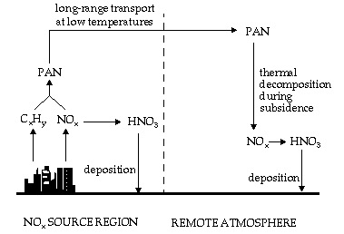
Reactions of NO and NO₂
Role of PAN in tropospheric chemistry: NO_{x} reservoir and vehicle for long-range transport of NO_{x}
Notes:
PAN is known to play an important role in tropospheric chemistry. its thermal
decomposition releases both NO2 and an organic free radical, so that it can act as an NOx reservoir and
ultimately as a source of OH in the dark.

Slide 24
Hydrocarbon oxidation in the atmosphere
OH
NO, ClO, BrO
CH₄
HO₂
formaldehyde
OH, Cl, O(¹D)
O₂
HCHO
alkyl radical
CH₃
methoxy radical
CH₃O
HCO
O₂
NO, ClO, BrO
CH₃OO
CO
peroxy radical
CO₂
Notes:
See also Smog chemistry in
http://butane.chem.uiuc.edu/pshapley/environmental/L15/2.html

Slide 25
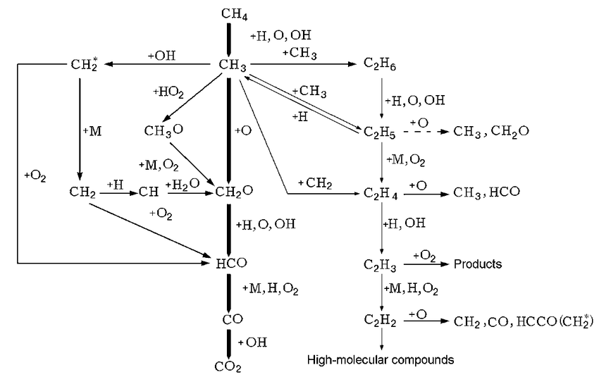
Reaction mechanisms for CH₄ combustion
One of the most famous mechanism for CH₄ combustion in air comprises 325 reactions and 53 species. It is proposed to model natural gas combustion, including NO_{x} formation
Simplified version: CH₄ combustion in pure O₂

Slide 26
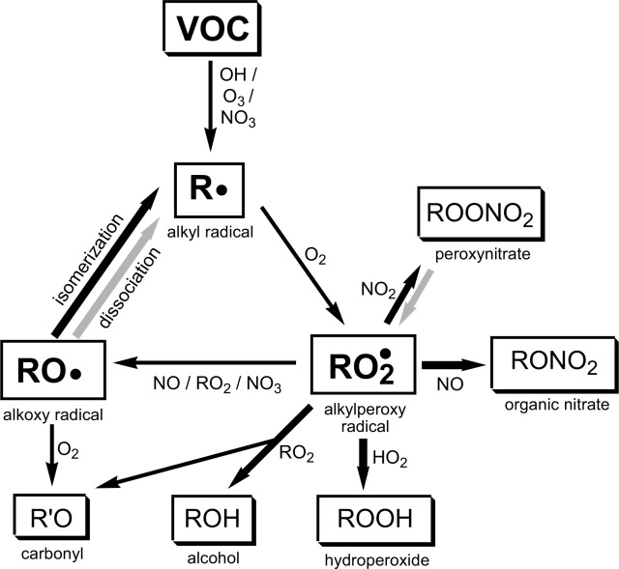
Oxidation mechanisms of generic VOC
major recognized oxidants during daytime (photolytic generation)
oxidation
Contributes at night (strong absorption in the visible + photodissociation)
NO₃ formation:
NO₂+O₃ → NO₃+O₂
Notes:
The major recognized oxidants for organics in the troposphere are OH and 03, with a contribution from
NO 3 at night.
OH: mechanisms of formation oxidant during daytime due to photolytic generation
O3: gia visto
NO3: The nitrate radical is formed by the reaction of NO 2
with O3“ NO 2 + 03 ~ NO 3 + 0 2. ( 8 )
NO 3 only exists in sufficient concentrations to play a role in nighttime chemistry,
due to its strong absorption of light in the visible and subsequent photodissociation.
HO2:
FinlaYSON pag 200 pdf. Organic species get oxidized

Slide 27
Oxidation rates for organic species
Notes:
Oxidation rates of various organic species by reaction with different radicals
Tabelle delle rate di ossidazione delle sostanze organiche in base alla loro classe a seconda del tipo di
ossidante

Slide 29
NO_{x} production
Production of fuel NO_{x}
NO_{x} production due to the N content in hydrcarbon fuels (accounts only for 0.1-2%). Complex reaction scheme
O, OH
H
HCN
HNCO, NCO, CN
NH₂⋅, NH⋅
N containing fuel
mostly
O, OH
NH₃
NH₂⋅, NH⋅, N⋅
NO
slow
Formation of NO₂
NO⋅ + H₂O → NO₂ + OH⋅
oxid
NH₃, NH₂, NH, N
red
N₂
Notes:
Fuel NOx arises from the reaction of the organically bound nitrogen in the fuel with oxygen. The process is complex (reaction schemes typically consider of the order of 50 intermediate species and several hundred separate reversible reactions, and there is still considerable uncertainty as to the true value of the various rate constants, etc.), but can be simply expressed as follows:
ii) Volatile fuel nitrogen is evolved mainly as HCN (and NH3) during the processes.
iii) The HCN reacts with various free radical species (O, OH) to form intermediates such as CN, NCO, HNCO and ultimately with reaction with H to produce NH, NH2.
Fuel NOx can be most effectively minimised by burning the fuel by staged combustion, which implies delayed mixing between the fuel gas and air.

