Slide 1
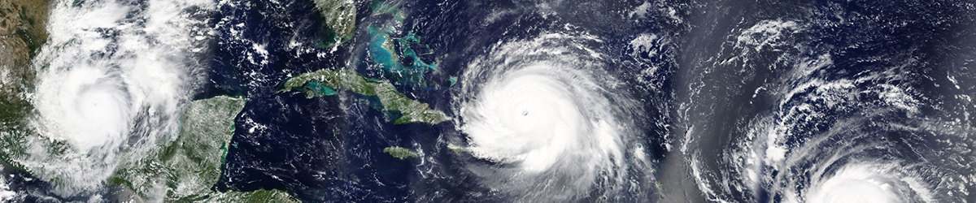
University of Trento
Master of Science in Environmental Meteorology https://international.unitn.it/environmental-meteorology
A.A. 2023-24
Environmental Physical Chemistry
Basic principles of chemical kinetics
Daniela Ascenzi
Dept. Physics, University of Trento, Italy
e-mail: daniela.ascenzi@unitn.it

Slide 2
Reactions in atmosphere
Photodissociation of molecules has a very important secondary effect  they produced radicals or molecules/atoms in internally excited states
Radicals and excited species CAN induce a series of chemical reactions in the gaseous phase
These processes are of great importance in the chemical evolution of the atmosphere and are competitive with the photodissociations in controlling the concentration of minor species.

Slide 3
Reactions in atmosphere
As example:
Formaldehyde (H₂CO) can be photodissociated by UV radiation or it can result in chemical reactions with oxidizing species
HCHO + hν → photolysis products (1)
HCHO + OH → H₂O + HCO (2)
HCHO + HO₂ + M → HO₂CH₂O + M (3)
HCHO + NO₃ → HNO₃ + HCO (4)
All these pathways compete in the removal of formaldehyde. Their contribution varies depending on the presence of pollutants and at night compared to the day.
In polluted conditions, the OH e HO₂ concentration is such that their reactions are competitive with photodissociation. In clean air conditions, instead, photodissociation prevails. The reaction with the NO₃ radical occurs during the night

Slide 4
Reactions of excited species
If a reactant is excited, this has two impacts on the reaction:
Higher energy ⇒ activation barriers can be overcome more readily ⇒ faster reactions
Electronic structure is altered ⇒ increased/decreased speed of reaction, depending on details
Example 1:
Example 2:

Slide 5
Reactions in atmosphere
To establish the importance of a certain chemical reaction we need to know two aspects:
can it happen ?
How fast is it (compared to photodissociation) ?
Answer to Q1: Thermodynamics
Answer to Q2: Chemical kinetics

Slide 6


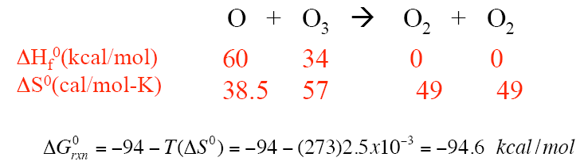
Thermodynamics
Reactions occur spontaneosly when:
Gibbs free energy
Thermodynamic function defined in terms of H (enthalpy), T (absolute temperature) and S (entropy)
0: standart state (1 atm, T=298K)
For bimolecular reactions in the gas phase:
Example:
A very little contributions (-0.6 kcal/mol) comes from the entropy variation (negligible with respect to ΔH⁰=-94 kcal/mol)

Slide 7

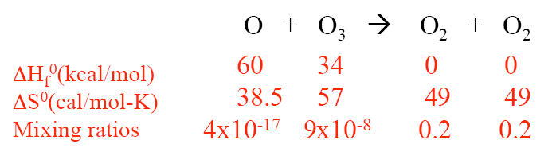
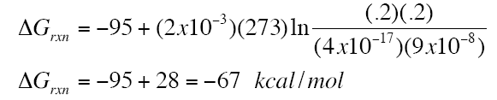
Thermodynamics
However, we are not at 25°C and 1 atm
(R universal gas constant)
where Q is the reaction quotient. If we use the real values, by referring to the mixing ratio (molar fraction)

Slide 8
Chemical kinetics: some terminology
Reactants: individual chemical species that participate in reactions. Several types are important in atmospheric processes (in addition to neutral species):
Free radicals: neutral compounds containing an odd number of electrons. They are highly reactive. The most important in atmospheric chemistry is the OH radical:
Ions: atom (or molecule) that carries a positive (CATION) or negative (ANION) charge, as a result of having lost or gained one (or more) electrons. Ions are important:
upper atmosphere: (above 6-10 km for cosmic rays)
in clouds (lightning from thunderstorms)
liquid droplets (aereosols) – e.g. dissolution of nitric acid (HNO₃) in clouds or fog is one of the main contributors (along with H₂SO₄) to «acid rain»

Slide 9
Chemical kinetics: reaction velocity
Given a generic reaction:
aA + bB → cC + dD
the reaction velocity v is the change in concentration of reagents (Δ[A] or Δ[B], decreasing) or of products (Δ[C] or Δ[D], increasing) in a given time interval Δt
t=0 [A]₀ [B]₀ [C]₀ [D]₀
t [A] [B] [C] [D]
t + Δt [A]+Δ[A] [B]+Δ[B] [C]+Δ[C] [D]+Δ[D]
average reaction velocity
When Δt → 0 :
instantaneous velocity

Slide 10
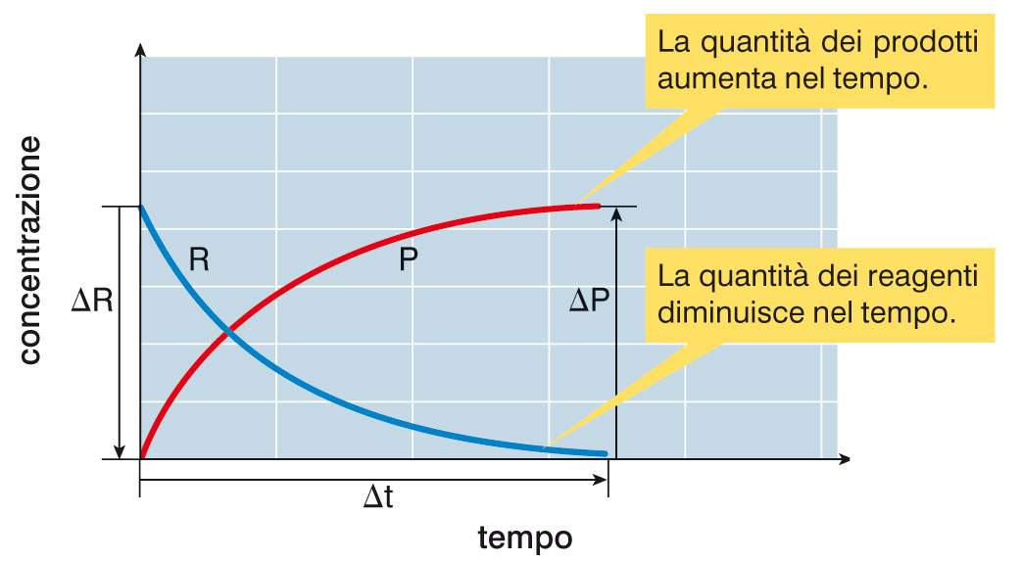
Chemical kinetics: reaction velocity
  Quantity of products increase with time
  concentration
  Quantity of regents decrease with time
  time
  Factors affecting the reaction velocity:
  nature (and concentration) of reagents
  temperature
  contact surface among reagents/collision frequencies
  Presence of catalyzers
Notes:
To measure reaction rate, we measure the concentration of either a reactant or product at several time intervals.

Slide 11
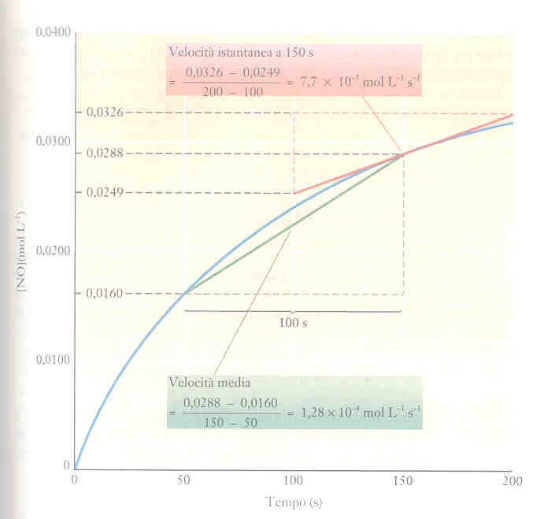
Reaction velocity: a real example
NO_{2(g)} + CO_{(g)} → NO_{(g)} + CO_{2(g)}
Instantaneous velocity (derivative = tangent)
Δ[NO]
[NO]
Average reaction velocity
Δt
time , t

Slide 12
Elementary vs overall reactions
Elementary reactions: they can not be broken down into two or more simple reactions. They are the results of the encounter (collisions) of two (or max three) species. Not more due to low probability:
Unimolecular reactions
e.g. thermal decomposition of PAN (peroxyacetyl nitrate)
Bimolecular reactions
e.g. formation of nitrate radicals
Termolecular reactions
e.g. formation of ozone
Overall reactions: they include two (or more) elementary reactions. Reactions with 4 or more reactants cannot be elementary

Slide 13
Reaction rate law
For a general overall reaction:
aA + bB → cC + dD
the rate law has the form:
The rate law relates the reaction velocity with the concentrations of reagents via a proportionality constant
k = rate constant (units depend on the tipe of law)
n, m, p, q = partial order of reaction. They can be zero, integer or fraction
n+m+p+q = global order of reaction
(global) First order reactions
or
(global) Second order reactions
or
or
(global) Third order reactions
or

Slide 14
Units of rate coefficients
Reaction velocity
units are molecule⋅cm⁻³s⁻¹
Reaction type | Rate law | units of k
First order reaction |  | s⁻¹
Second order reaction |  | cm³⋅molecule⁻¹s⁻¹
Third order reaction |  | cm⁶⋅molecule⁻²s⁻¹
Rate coefficents (k) vary with T and P (in some cases)
As we will see later on
Notes:
Situation 2a is the situation that the initial concentration of the two reactants are not equal. Let xx be the concentration of each species reacted at time tt.
Let [A]0=a[A]0=a and [B]0=b[B]0=b, then [A]=a−x[A]=a−x ;[B]=b−x[B]=b−x. The expression of rate law becomes:
To solve this integral, we use the method of partial fractions
See derivation in
https://chem.libretexts.org/Textbook_Maps/Physical_and_Theoretical_Chemistry_Textbook_Maps/Supplemental_Modules_(Physical_and_Theoretical_Chemistry)/Kinetics/Reaction_Rates/Second-Order_Reactions

Slide 15
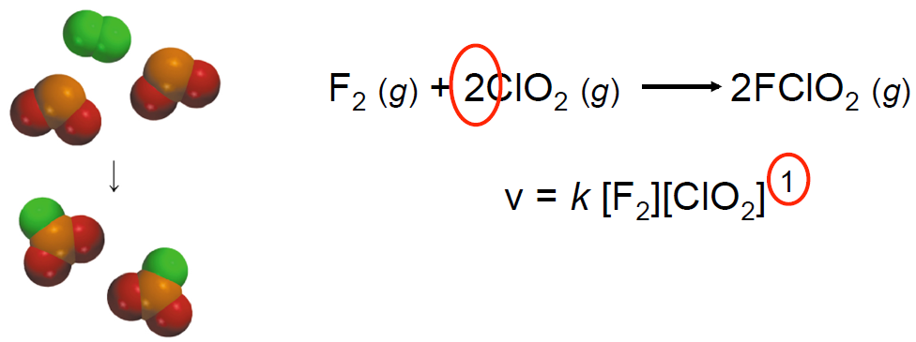
Reaction rate law
The rate laws are always determined experimentally
For almost all gas-phase atmospheric reactions the reaction order is defined in terms of reagents’ concentrations only (i.e. p=0, q=0)
In overall reactions the exponents in the rate law (i.e. m, n, p, q) are NOT necessarily related to the stochiometric coefficients (i.e. a, b, c, d)
Example:

Slide 16
Rate laws of elementary reactions
Only in this case the exponents in the rate law coincides with the stochiometric coefficients
Molecolarity: number of molecules reacting in the elementary process
Unimolecular reaction
only one reactant (e.g. photodissociations)
Bimolecular reactions
two reactants
Termolecular reactions
3-body collisions (the third body M does not really take part into the reaction - in atmospheric chemistry M is N₂/O₂)
In atmospheric chemistry we will have only elementary reactions
Notes:
The basis of the fact that the order coincides with stechiometric coefficients lies in the fact that they must occur during a single collision
(although the probability of reaction during any one collision is equal to or less than unity). Thus doubling the concentration of one reagent will double the number of collisions per second with the other reagent. Assuming the probability of reaction per collision remains constant, then the number of the two molecules
reacting, and the number of product molecules formed per unit time (i.e., the rate), must double.

Slide 17
Probability of termolecular reactions
1. How long is a collision?
2. How long is the time between two collisions?
  Collisions last ∼ 10⁻¹³ to 10⁻¹² s
let’s take the longer estimate 10⁻¹² s
  2. Time between two collisions ∼ 10⁻¹⁰ -10⁻⁹ s
let’s take the longer estimate 10⁻⁹ s (we will derive this later on)
We can calculate the mean collision duration/total time = 10⁻¹² / 10⁻⁹ ∼ 10⁻³ probability of having two molecules colliding
Probability of having three molecules colliding simultaneously is ∼ (10⁻³)² = 10⁻⁶
→ Hence it is more likely to have processes occurring as a series of bimolecular collisions
→ There are no quadrimolecular processes (far too low prob)

Slide 18

Exercise n. 1 - Kinetics
The rate of formation of NH₃ in the reaction:
N_{2(g)} + 3H_{2(g)} → 2NH_{3(g)}
was reported as 1.2 mmol⋅dm⁻³s⁻¹ under a certain set of conditions.
What is the rate of consumption of H₂?
Express this rate in units of molecules⋅cm⁻³s⁻¹

Slide 19
Exercise n. 1 - Kinetics
The rate of formation of NH₃ in the reaction:
N_{2(g)} + 3H_{2(g)} → 2NH_{3(g)}
was reported as 1.2 mmol⋅dm⁻³s⁻¹ under a certain set of conditions.
What is the rate of consumption of H₂?
Express this rate in units of molecules⋅cm⁻³⋅s⁻¹
Solution
v_{NH3}= d[NH3]/dt
rate of consumption v_{H2}=3/2*v_{NH3}= 1.8 mmol⋅dm−3⋅s−1
b) mmol=10⁻³ mol=10⁻³⋅N_{a}=6.022⋅10²⁰ and dm⁻³=10⁻³ cm³
So that 1.8x6.022⋅10²⁰x10⁻³ = 1.08x10¹⁸ molecule⋅cm⁻³⋅ s⁻¹

Slide 20
Exercise n. 2 - Kinetics
A reaction has a rate law of the form k[A]²[B]. What are the units of the rate constant k if the reaction rate was measured in mol⋅dm⁻³s⁻¹?
Solution
Reaction rate v=k[A]²[B]. From the dimensional analysis:
v is in mol⋅dm⁻³s⁻¹
[A]² is in mol²⋅dm⁻⁶
[B] is in mol⋅dm⁻³
k will be mol⋅dm⁻³s⁻¹ / mol³⋅dm⁻⁹ = mol⁻²⋅dm⁶⋅ s⁻¹

Slide 21
Rate laws of elementary reactions
Only in this case the exponents in the rate law coincides with the stochiometric coefficients
Molecolarity: number of molecules reacting in the elementary process
Unimolecular reaction
only one reactant (e.g. photodissociations)
Bimolecular reactions
two reactants
Termolecular reactions
3-body collisions (the third body M does not really take part into the reaction - in atmospheric chemistry M is N₂/O₂)
In atmospheric chemistry we will have only elementary reactions
Notes:
The basis of the fact that the order coincides with stechiometric coefficients lies in the fact that they must occur during a single collision
(although the probability of reaction during any one collision is equal to or less than unity). Thus doubling the concentration of one reagent will double the number of collisions per second with the other reagent. Assuming the probability of reaction per collision remains constant, then the number of the two molecules
reacting, and the number of product molecules formed per unit time (i.e., the rate), must double.

Slide 22
First order reactions
A → products
units are time⁻¹ (e.g. s⁻¹)
[A]
time
Half-life (t_{1/2} ): time required for [A] to reduce to half of the initial value
At t_{1/2} [A]=[A]₀/2
Natura lifetime (τ): time required for [A] to reduce by a factor 1/e
At τ [A]=[A]₀/e
Notes:
Arrivata qui Lezione del 3 ottobre 2023

Slide 23
Second order reactions
With single reactants
A + A → prodotti
units are conc⁻¹⋅time⁻¹ (eg. cm³⋅molecules⁻¹⋅s⁻¹)
1/[A]
slope = k
1/[A]₀
time
Half-life (t_{1/2} ):
At t_{1/2} [A]=[A]₀/2
Natura lifetime (τ):
At τ [A]=[A]₀/e

Slide 24
Second order reactions
With different reactants
A + B → prodotti
units are conc⁻¹⋅time⁻¹ (eg. cm³⋅molecules⁻¹⋅s⁻¹)
Assuming: different initial values
x concentration of each specise reacted at time t
→ continue in the next slide
Notes:
Situation 2a is the situation that the initial concentration of the two reactants are not equal. Let xx be the concentration of each species reacted at time tt.
Let [A]0=a[A]0=a and [B]0=b[B]0=b, then [A]=a−x[A]=a−x ;[B]=b−x[B]=b−x. The expression of rate law becomes:
To solve this integral, we use the method of partial fractions
See derivation in
https://chem.libretexts.org/Textbook_Maps/Physical_and_Theoretical_Chemistry_Textbook_Maps/Supplemental_Modules_(Physical_and_Theoretical_Chemistry)/Kinetics/Reaction_Rates/Second-Order_Reactions

Slide 25
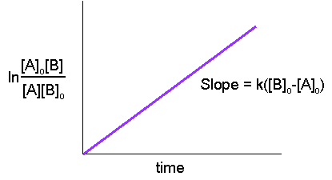
Second order reactions
With different reactants
A + B → prodotti
→ continuation:
Half-life and natural lifetime:
Cannot be easily defined: they are different for A and B
BUT
In the assumption that [B] is constant with time → problem reduces to a first order reaction with k’=k[B]
Similar assumption for third order reactions: [B] and [C] constants
pseudo-first order
Notes:
Situation 2a is the situation that the initial concentration of the two reactants are not equal. Let xx be the concentration of each species reacted at time tt.
Let [A]0=a[A]0=a and [B]0=b[B]0=b, then [A]=a−x[A]=a−x ;[B]=b−x[B]=b−x. The expression of rate law becomes:
To solve this integral, we use the method of partial fractions
See derivation in
https://chem.libretexts.org/Textbook_Maps/Physical_and_Theoretical_Chemistry_Textbook_Maps/Supplemental_Modules_(Physical_and_Theoretical_Chemistry)/Kinetics/Reaction_Rates/Second-Order_Reactions

Slide 26
Exercise n. 3 - Kinetics
The variation in the partial pressure p_{A} of azomethane (CH₃N₂CH₃) with time was followed at T=460 K, with the results given in the Table.
Confirm that the decomposition reaction: CH₃N₂CH₃(g) → C₂H_{6(g)} + N_{2(g)} is first-order in CH₃N₂CH₃, and find the rate constant at this temperature.
time (s) | p_{A} (10⁻² torr)
0 | 10.2
1000 | 5.72
2000 | 3.99
3000 | 2.78
4000 | 1.94

Slide 27
Exercise n. 3 - Kinetics
The variation in the partial pressure p_{A} of azomethane (CH₃N₂CH₃) with time was followed at T=460 K, with the results given in the Table.
Confirm that the decomposition reaction: CH₃N₂CH₃(g) → C₂H_{6(g)} + N_{2(g)} is first-order in CH₃N₂CH₃, and find the rate constant at this temperature.
time (s) | p_{A} (10⁻² torr)
0 | 10.2
1000 | 5.72
2000 | 3.99
3000 | 2.78
4000 | 1.94
Solution The easiest procedure is to plot ln(p_{A} / Torr) against t/s and expect to obtain a straight line. If the graph is straight, then the slope is −k. To determine the slope use mathematical software, which automatically determines the best straight line through the data points and calculates the slope.

Slide 28
Exercise n. 3 - Kinetics
Solution (continue)
We draw up the following table:
t/s 0 1000 2000 3000 4000
pA/(10−2 Torr) 10.20 5.72 3.99 2.78 1.94
ln(pA/Torr) −2.28 −2.86 −3.22 −3.58 −3.94
The plot is straight, confirming a first-order reaction. Its least-squares best-fit slope is −4.04×10⁻⁴, so k = 4.04×10⁻⁴ s⁻¹.

Slide 29
Exercise n. 4 - Kinetics
The rate constant k for the decomposition reaction:
N₂O_{5(g)} → 2NO_{2(g)} + 1/2O_{2(g)}
is equal to k= 6.76x10⁻⁵ s⁻¹ at 25°C and the reaction is first-order in N₂O₅.
Calculate the half-life and the natural lifetime of N₂O₅.
at what time do you expect the [N₂O₅] to be reduced by a factor 1/8 respect to its initial value?

Slide 30
Exercise n. 4 - Kinetics
The rate constant k for the decomposition reaction:
N₂O_{5(g)} → 2NO_{2(g)} + 1/2O_{2(g)}
is equal to k= 6.76x10⁻⁵ s⁻¹ at 25°C and the reaction is first-order in N₂O₅.
Calculate the half-life and the natural lifetime of N₂O₅.
at what time do you expect the [N₂O₅] to be reduced by a factor 1/8 respect to its initial value?
Solution
a) The half-life for a first order reaction is defined as t_{1/2}=ln2/k. Hence t_{1/2}=0.693/6.76x10⁻⁵ s=2.85 h. Natural lifetime τ=1/k. Hence τ=1/6.76x10⁻⁵ s=4.11 h

Slide 31
Exercise n. 4 - Kinetics
The rate constant k for the decomposition reaction:
N₂O_{5(g)} → 2NO_{2(g)} + 1/2O_{2(g)}
is equal to k= 6.76x10⁻⁵ s⁻¹ at 25°C and the reaction is first-order in N₂O₅.
Calculate the half-life and the natural lifetime of N₂O₅.
at what time do you expect the [N₂O₅] to be reduced by a factor 1/8 respect to its initial value?
Solution
b) It can be calculated by substituting [A]/[A]₀=1/8=0.125 in the integrated rate law expression to get:
ln0.125=-kt from which t= -ln0.125/k=2.079/6.76x10⁻⁵ s =8.54 h. It can also be seen as a succession of half-lives (see graph)

Slide 32
Exercise n. 5 - Kinetics
The decomposition of species A via the first order reaction: A_{(g)} → B_{(g)} + C_{(g)}
has a natural lifetime of 7.3 hours. What is the value of the rate coefficient?
Solution Natural lifetime τ=1/k.
7.3 hours = 7.3x3600 s=26280 s
Hence k=1/26280 s⁻¹=3.81x10⁻⁵ s⁻¹

Slide 33
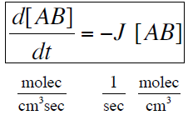
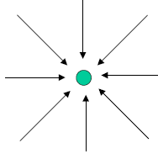

Photodissociation reaction rates
The photodissociatio rate of AB is directly proportional to AB number density
first order reaction
J (s⁻¹) depends on:
    light intensity (in all direction)
    absorption cross section σ
    photodissociation quantum yield
    wavelength

Slide 34
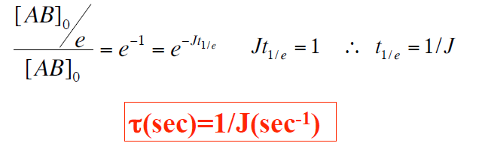
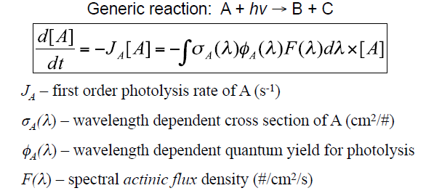
Photodissociation reaction rates
Life time is defined as the time necessary for the initial concentration to be reduced by one factor 1/e

Slide 35
Pseudo-first order reactions
Question:
Among the following reactions occurring in atmosphere which one could be most easily approximated as a pseudo-first order reaction?
1. CH₃OO• + NO → CH₃O + NO₂
2. CH₃O• + O₂ → CH₂O + HO₂
3. HO₂ + O₃ → OH + 2O₂
Answer:
Process 2, due to the much larger abundance of O₂ in atmosphere compared to any of the other reagents
For reactions of interest in the atmosphere, the pseudo-first order simplification can often be made in view of the fact that reagents are typically one radical (whose concentration is very low) and an abundant molecular partner
Notes:
Situation 2a is the situation that the initial concentration of the two reactants are not equal. Let xx be the concentration of each species reacted at time tt.
Let [A]0=a[A]0=a and [B]0=b[B]0=b, then [A]=a−x[A]=a−x ;[B]=b−x[B]=b−x. The expression of rate law becomes:
To solve this integral, we use the method of partial fractions
See derivation in
https://chem.libretexts.org/Textbook_Maps/Physical_and_Theoretical_Chemistry_Textbook_Maps/Supplemental_Modules_(Physical_and_Theoretical_Chemistry)/Kinetics/Reaction_Rates/Second-Order_Reactions

Slide 36
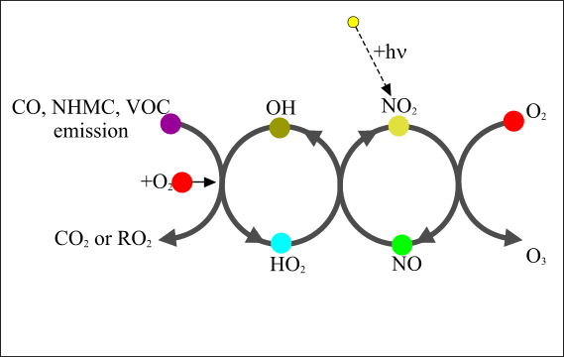
Lifetimes in atmospheric chemistry
methane
cm³⋅molecules⁻¹⋅s⁻¹ (at 298K)
propane (a non-methane HC)
cm³⋅molecules⁻¹⋅s⁻¹ (at 298K)
Assuming an average (and constant) daytime concentration
[OH]=1x10⁶ molecules⋅cm⁻³
years
days
NMHCs reacts much faster then CH₄ with OH → they can contribute to O₃ formation and photochemical smog
Notes:
These calculations illustrate why regulatory agencies have concentrated on controlling "non-methane hydrocarbons.“ Because methane reacts so slowly in the
troposphere, it is generally not of concern from the point of view of ozone formation in urban areas, i.e., over the time scale of hours to a few days. It is also the
reason that CH 4 is the only organic to survive long enough in the troposphere to cross the tropopause and enter the stratosphere in significant concentrations (see
Chapter 12). On the other hand, propane reacts sufficiently quickly that it can contribute to local and regional photochemical smog formation
For tropospheric O3 problem see http://elte.prompt.hu/sites/default/files/tananyagok/AtmosphericChemistry/ch08s02.html

Slide 37
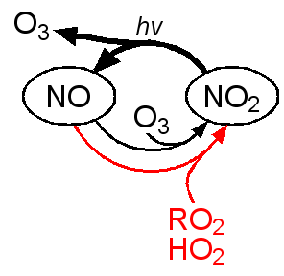
O₃ production in the troposphere
A similar reaction sequence for methane CH₄ or heavier hydrocarbons:
(1) CH₄ + OH → CH₃ + H₂O
(2) CH₃ + O₂ + M → CH₃O₂ + M
(3) CH₃O₂ + NO → NO₂ + CH₃O
(4) CH₃O + O₂ → H₂CO + HO₂
(5) HO₂ + NO → NO₂ + OH
(6) NO₂ + hν → NO + O
(7) O + O₂ + M → O₃ + M
--------------------------------
(1-7) CH₄ + 4O₂ + hν → 2O₃ + H₂CO + H₂O overall reaction
Eq. (1) to (7) are elementary reactions
Notes:
The presence of peroxy radicals, from the oxidation of hydrocarbons, disturbs the O₃-NO-NO₂ cycle and leads to a net production of ozone
Both meteorology and photochemistry play important roles in local and global ozone chemistry.
Transport from the stratosphere represents a natural source of ozone.
VOC’s plus NOx make a photochemical source.
HOx reactions and dry deposition are sinks.

Slide 38
Lifetimes in atmospheric chemistry
Lifetimes due to gas phase chemical reactions are always in competition with other processes in which the reactant maybe involved (e.g. transport, photolysis, heterogeneous chemistry, depositions...)
What can happen to CH₄ in the troposphere?
1. Reaction with OH (see previous slide) τ_{OH} ≈ 5 years
2. Transport to stratosphere τ_{trans} ≈ 8 years
3. Loss to soil τ_{soil} ≈ 100 years
4. Photolysis: CH₄+hν→CH₃+H (λ<276nm) τ_{phot} ≈ 300 years
+ small absorption cross sections in the UV
5. Reaction with NO₃: CH₄+NO₃ → CH₃+HNO₃ τ_{NO3} ≈ 30 years
6. Reaction with Cl: CH₄+Cl→ CH₃+HCl τ_{Cl} ≈ 300 years
7. Reaction with O₃: CH₄+O₃→ products τ_{O3} ≈ 250 years
8. Rainout/particle uptake τ_{uptake} very long
CH₄ is not very soluble in water or sticky to particles
Notes:
Photolysis: absoprtion cross section of CH4 is maximum in the VUV that does not penetrate in the troposphere. At lambda 276 the absorption is very small 10-24

Slide 39
Lifetime for multiple loss processes
How can we estimate the lifetime of CH₄ taking into account all the loss processes?
Rate coefficients can be added to get a total loss rate coefficient:
The k_{i} must have the same units (i.e. they must be reduced to pseudo-first order processes, units s⁻¹)
Lifetimes adds as equivalent resistor networ:
What is the overall lifetime of CH₄ (from previous slides)?
Only processes with short lifetimes are relevant
Notes:
Photolysis: absoprtion cross section of CH4 is maximum in the VUV that does not penetrate in the troposphere. At lambda 276 the absorption is very small 10-24

Slide 40
Branching ratios in elementary reactions
Given an elementary reaction between A and B reagents more than one combination of products (also called «channels») is possible:
Branching ratio (B.R.)
is the relative ratio (or % value) of different products formed in an elementary reaction
so that
Usually it is possible to measure k_{tot} and the various B.R.(i), from which the k_{i} can be obtained:
Notes:
one might expect the rate to increase with the concentration or pressure of the third body M. However, there
clearly must be some limit since the rate cannot increase to infinity but only to some upper limit determined by how fast the two reactive species can combine
chemically. As a result, one might intuitively expect the rates of termolecular reactions to increase initially as the pressure of M is increased from zero
and then to plateau at some limiting value at high pressures. Let us take the reaction of OH with NO2 as an example of a termolecular reaction of atmospheric
interest and examine how its pressure dependence is established. It is common in kinetic studies to follow the decay of one reactant in an excess of the second
reactant. In the case of reaction, the decay of OH is followed in the presence of excess NO2 and the third body M, where M is an inert "bath" gas such as He,N2, Ar
If [M] is constant, KIII and [M] can be combined to form an effective bimolecular rate constant, kbim
Since NO2 is in great excess, its concentration does not change significantly even when all the OH has reacted and hence it remains approximately constant throughout
the reaction at its initial value, [NO2 ]0. Rearranging the rate law and integrating from time t = 0 when the initial concentration of OH is [OH] 0 to time t when the
OH concentration is [OH], one obtains
A plot of these decay rates against [NO2] 0 should thus be linear, with the slopes increasing with pressure since kbim depends on [M].
Figure shows such a plot of the absolute values of the observed OH decay rates against [NO2] 0 at total
pressures of Ar from 50 to 402 Torr. As expected, the decay rates are linear with [NO2]0 and increase with the pressure of M.

Slide 41
Branching ratios: example
The reaction between the radicals HCO and NO₂ results in the followin channels:
B.R.
0.42
0.1
<0.01
?
The total rate coefficient at 296 K is measured to be k_{tot}=5.7x10⁻¹¹ cm³⋅molecule⁻¹s⁻¹
Question: determine k₁, k₂, k₃ and k₄
Notes:
one might expect the rate to increase with the concentration or pressure of the third body M. However, there
clearly must be some limit since the rate cannot increase to infinity but only to some upper limit determined by how fast the two reactive species can combine
chemically. As a result, one might intuitively expect the rates of termolecular reactions to increase initially as the pressure of M is increased from zero
and then to plateau at some limiting value at high pressures. Let us take the reaction of OH with NO2 as an example of a termolecular reaction of atmospheric
interest and examine how its pressure dependence is established. It is common in kinetic studies to follow the decay of one reactant in an excess of the second
reactant. In the case of reaction, the decay of OH is followed in the presence of excess NO2 and the third body M, where M is an inert "bath" gas such as He,N2, Ar
If [M] is constant, KIII and [M] can be combined to form an effective bimolecular rate constant, kbim
Since NO2 is in great excess, its concentration does not change significantly even when all the OH has reacted and hence it remains approximately constant throughout
the reaction at its initial value, [NO2 ]0. Rearranging the rate law and integrating from time t = 0 when the initial concentration of OH is [OH] 0 to time t when the
OH concentration is [OH], one obtains
A plot of these decay rates against [NO2] 0 should thus be linear, with the slopes increasing with pressure since kbim depends on [M].
Figure shows such a plot of the absolute values of the observed OH decay rates against [NO2] 0 at total
pressures of Ar from 50 to 402 Torr. As expected, the decay rates are linear with [NO2]0 and increase with the pressure of M.

Slide 42
Exercise n. 6 - Kinetics
The survival time of CFCs (chlorofluorocarbons) in the troposphere is determined essentially by the lifetime of their reaction with OH radicals. The rate coefficients for the bimolecular reactions of CFC-11 (CFCl₃) and HCFC-21 (CHFCl₂) with OH are:
CFCl_{3(g)} + OH_{(g)} → CCl₂F_{(g)} + HOCl_{(g)} k_{CFC-11}=5.2x10⁻¹⁸ cm³⋅molecule⁻¹s⁻¹
CHFCl_{2(g)} + OH_{(g)} → CCl₂F_{(g)} + H₂O_{(g)} k_{HCFC-21}=2.6x10⁻¹⁴ cm³⋅molecule⁻¹s⁻¹
Assuming a constant concentration of OH in the troposphere (equal to 10⁶ molecule⋅cm⁻³):
determine the natural lifetime of CFC-11 and HCFC-21 in the trophosphere.
which of the two CFC do you expect to be more effective at destroying stratospheric O₃, and why?

Slide 43
Exercise n. 6 - Kinetics
CFCl_{3(g)} + OH_{(g)} → CCl₂F_{(g)} + HOCl_{(g)} k_{CFC-11}=5.2x10⁻¹⁸ cm³⋅molecule⁻¹s⁻¹
CHFCl_{2(g)} + OH_{(g)} → CCl₂F_{(g)} + H₂O_{(g)} k_{HCFC-21}=2.6x10⁻¹⁴ cm³⋅molecule⁻¹s⁻¹
[OH] = 10⁶ molecule⋅cm⁻³
Solution
a) In both cases we apply the pseudo-first order expression for the natural lifetimes τ=1/k[OH] to get:
τ_{CFC-11}=1/k[OH]=1/(5.2x10⁻¹⁸⋅10⁶) cm⁻³⋅molecule⋅s/molecule⋅cm⁻³ =1.923x10¹¹ s=6098 years
τ_{HCFC-21}=1/k[OH]=1/(2.6x10⁻¹⁴⋅10⁶) cm⁻³⋅molecule⋅s/molecule⋅cm⁻³ =3.846x10⁷ s=1.22 years

Slide 44
Exercise n. 6 - Kinetics
CFCl_{3(g)} + OH_{(g)} → CCl₂F_{(g)} + HOCl_{(g)} k_{CFC-11}=5.2x10⁻¹⁸ cm³⋅molecule⁻¹s⁻¹
CHFCl_{2(g)} + OH_{(g)} → CCl₂F_{(g)} + H₂O_{(g)} k_{HCFC-21}=2.6x10⁻¹⁴ cm³⋅molecule⁻¹s⁻¹
[OH] = 10⁶ molecule⋅cm⁻³
Solution
b) CFC-11 has a much longer lifetime for reaction with OH radicals in the troposphere, hence it will have more chances to be transported to the stratosphere where it can damage O₃.
On the other hand HCFC-21 reacts much faster with OH, so it is destroyed in the troposphere and it is far less effective at destroying stratospheric O₃

Slide 45
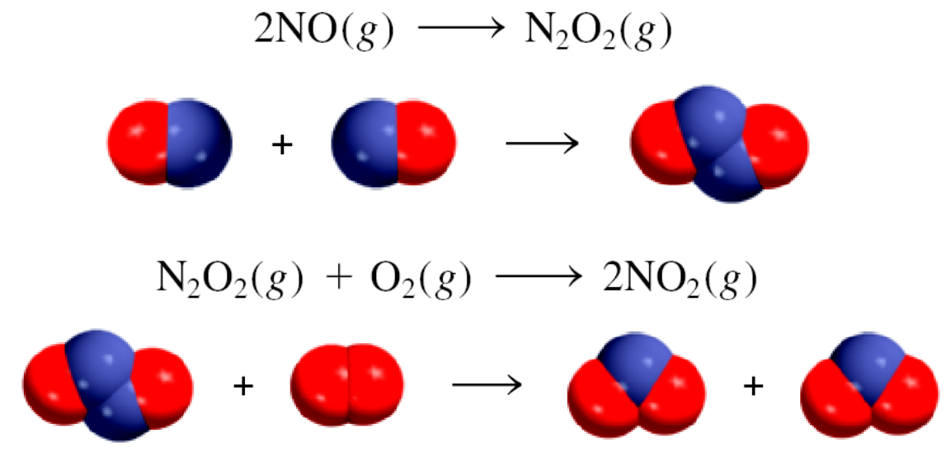
Reaction mechanisms
Progress of a reaction can be represented by a series of elementary steps
Reaction mechanism: the sequence of elementary steps leading to the formation of products
Example:

Slide 46
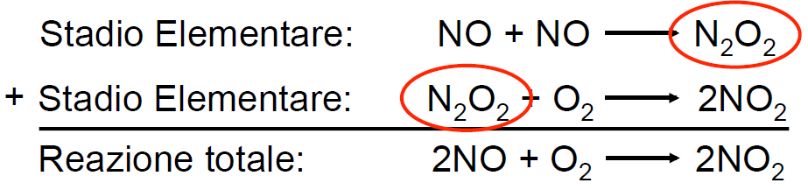
Reaction mechanisms
1° elementary step:
2° elementary step:
Total reaction:
Reaction intermediates are chemical species that appear in a reaction mechanism (are produced during a reaction step) but do NOT appear in the rate law and in the balance of the overall reaction
A reaction intermediate is always formed in a preceeding step and it is consumed in a subsequent step

Slide 47
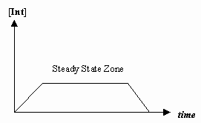
Steady-state approximation
Method to derive rate laws in the presence of one (or more) reaction intermediates
Reaction intermediate:
Not a reactant, not a product. A species that transiently exists during the course of the reaction
Steady-state approximation:
intermediate X is consumed as quickly as it is generated. → [X] is constant in a duration of the reaction
A mathematically intractable set of coupled differential equations is converted into a system of simultaneous algebraic equations (one for each species involved in the reaction)
The algebraic equations may be solved to find the concentrations of the reactive intermediates, and these may then be substituted back into the more general equations to obtain an expression for the overall rate law
Notes:
https://chem.libretexts.org/Textbook_Maps/Physical_and_Theoretical_Chemistry_Textbook_Maps/Supplemental_Modules_(Physical_and_Theoretical_Chemistry)/Kinetics/Reaction_Mechanisms/Steady-State_Approximation

Slide 48
Steady-state approximation: example 1.
Assuming [OH] to be in a steady state:
Rearranging:
Can obtain an approximate value for [OH] without measuring directly
Notes:
https://chem.libretexts.org/Textbook_Maps/Physical_and_Theoretical_Chemistry_Textbook_Maps/Supplemental_Modules_(Physical_and_Theoretical_Chemistry)/Kinetics/Reaction_Mechanisms/Steady-State_Approximation

Slide 49
Reaction mechanisms
Plausible reaction mechanisms must obey the following:
The sum of the elementary steps MUST give the overall balanced chemical equation
The step that determines the reaction velocity must predict the same rate law that is determined experimentally
The step that determins the overall reaction velocity is the slowest step in the mechanism leading to products
Example:
F_{2(g)} + 2ClO_{2(g)}→2FClO_{2(g)}
Mechanism:
1) F₂ + ClO₂ → FClO₂ + F
2) F + ClO₂ + M→ FClO₂ +M
with v₁ << v₂
The rate determining step is 1)

Slide 50
Termolecular processes and P dependence
OH + SO₂
Why M is important?
energy
Bond formation is exothermic. Collisions with M are required to stabilize HOSO₂
HO-SO₂
Rate increases with [M] but only up to an upper limit
To study experimentally: work under «pseudo-first order» conditions
Notes:
one might expect the rate to increase with the concentration or pressure of the third body M. However, there
clearly must be some limit since the rate cannot increase to infinity but only to some upper limit determined by how fast the two reactive species can combine
chemically. As a result, one might intuitively expect the rates of termolecular reactions to increase initially as the pressure of M is increased from zero
and then to plateau at some limiting value at high pressures. Let us take the reaction of OH with SO2 as an example of a termolecular reaction of atmospheric
interest and examine how its pressure dependence is established. It is common in kinetic studies to follow the decay of one reactant in an excess of the second
reactant. In the case of reaction, the decay of OH is followed in the presence of excess NO2 and the third body M, where M is an inert "bath" gas such as He,N2, Ar
If [M] is constant, KIII and [M] can be combined to form an effective bimolecular rate constant, kbim
Since NO2 is in great excess, its concentration does not change significantly even when all the OH has reacted and hence it remains approximately constant throughout
the reaction at its initial value, [NO2 ]0. Rearranging the rate law and integrating from time t = 0 when the initial concentration of OH is [OH] 0 to time t when the
OH concentration is [OH], one obtains
A plot of these decay rates against [NO2] 0 should thus be linear, with the slopes increasing with pressure since kbim depends on [M].
Figure shows such a plot of the absolute values of the observed OH decay rates against [NO2] 0 at total
pressures of Ar from 50 to 402 Torr. As expected, the decay rates are linear with [NO2]0 and increase with the pressure of M.

Slide 51
Termolecular processes and P dependence
We follow the decay rate of OH in the presence of excess SO₂ and constant third body M ("bath" gas, e.g. air):
pseudo-2nd order rate constant
1. Assuming [M] constant it can be combined with k^{III} to give:
2. SO₂ in great excess→[SO₂] constant=[SO₂]₀ → pseudo-first order
decay rate
with
Notes:
one might expect the rate to increase with the concentration or pressure of the third body M. However, there clearly must be some limit since the rate cannot increase to infinity but only to some upper limit determined by how fast the two reactive species can combine chemically. As a result, one might intuitively expect the rates of termolecular reactions to increase initially as the pressure of M is increased from zero and then to plateau at some limiting value at high pressures. Let us take the reaction of OH with NO2 as an example of a termolecular reaction of atmospheric interest and examine how its pressure dependence is established. It is common in kinetic studies to follow the decay of one reactant in an excess of the second reactant. In the case of reaction, the decay of OH is followed in the presence of excess NO2 and the third body M, where M is an inert "bath" gas such as He,N2, Ar
If [M] is constant, KIII and [M] can be combined to form an effective bimolecular rate constant, kbim
Since NO2 is in great excess, its concentration does not change significantly even when all the OH has reacted and hence it remains approximately constant throughout
the reaction at its initial value, [NO2 ]0. Rearranging the rate law and integrating from time t = 0 when the initial concentration of OH is [OH] 0 to time t when the
OH concentration is [OH], one obtains
A plot of these decay rates against [NO2] 0 should thus be linear, with the slopes increasing with pressure since kbim depends on [M].
Figure shows such a plot of the absolute values of the observed OH decay rates against [NO2] 0 at total
pressures of Ar from 50 to 402 Torr. As expected, the decay rates are linear with [NO2]0 and increase with the pressure of M.

Slide 52
Termolecular processes and P dependence
decay rate
with
A plot of the OH decay rates against [SO₂]₀ is linear, with the slopes increasing with the pressure of M
k^{bim} as a function of pressure of M
pressure of M
Notes:
one might expect the rate to increase with the concentration or pressure of the third body M. However, there
clearly must be some limit since the rate cannot increase to infinity but only to some upper limit determined by how fast the two reactive species can combine
chemically. As a result, one might intuitively expect the rates of termolecular reactions to increase initially as the pressure of M is increased from zero
and then to plateau at some limiting value at high pressures. Let us take the reaction of OH with NO2 as an example of a termolecular reaction of atmospheric
interest and examine how its pressure dependence is established. It is common in kinetic studies to follow the decay of one reactant in an excess of the second
reactant. In the case of reaction, the decay of OH is followed in the presence of excess NO2 and the third body M, where M is an inert "bath" gas
If [M] is constant, KIII and [M] can be combined to form an effective bimolecular rate constant, kbim
Since NO2 is in great excess, its concentration does not change significantly even when all the OH has reacted and hence it remains approximately constant throughout the reaction at its initial value, [NO2 ]0. Rearranging the rate law and integrating from time t = 0 when the initial concentration of OH is [OH] 0 to time t when the OH concentration is [OH], one obtains
A plot of these decay rates against [NO2] 0 should thus be linear, with the slopes increasing with pressure since kbim depends on [M].
Figure shows such a plot of the absolute values of the observed OH decay rates against [NO2] 0 at total
pressures of Ar from 50 to 402 Torr. As expected, the decay rates are linear with [NO2]0 and increase with the pressure of M.

Slide 53
Termolecular proc. & steady-state approx.
Three body reactions treated using steady state approximation
Association reactions can be seen as a sequence of two bimolecular reactions
Notes:
https://chem.libretexts.org/Textbook_Maps/Physical_and_Theoretical_Chemistry_Textbook_Maps/Supplemental_Modules_(Physical_and_Theoretical_Chemistry)/Kinetics/Reaction_Mechanisms/Steady-State_Approximation

Slide 54
Termolecular proc. & steady-state approx.
Three body reactions treated using steady state approximation
Apply steady-state approximation to [AB*]:
The rate of the 3-body reaction is defined as the formation rate of AB:
Substituting [AB*]:
Notes:
https://chem.libretexts.org/Textbook_Maps/Physical_and_Theoretical_Chemistry_Textbook_Maps/Supplemental_Modules_(Physical_and_Theoretical_Chemistry)/Kinetics/Reaction_Mechanisms/Steady-State_Approximation

Slide 55
Termolecular proc. & steady-state approx.
General rate expression for a three-body reaction
Two interesting limiting values:
1: low-pressure limit:
Due to the low pressure, AB* dissociates back to A+B more frequently than it collides with M (to remove excess energy via reaction 3).
The rate limiting step is how often energy is removed from AB* and the overall rate depends linearly on [M]
low-pressure limit rate constant
Notes:
https://chem.libretexts.org/Textbook_Maps/Physical_and_Theoretical_Chemistry_Textbook_Maps/Supplemental_Modules_(Physical_and_Theoretical_Chemistry)/Kinetics/Reaction_Mechanisms/Steady-State_Approximation

Slide 56
Termolecular proc. & steady-state approx.
General rate expression for a three-body reaction
2: high-pressure limit:
The overall rate is independent of [M]
With lots of M around collisions with M remove energy from AB* more frequently than AB* dissociating back to A + B
Step 1 (i.e. formation of AB*) is the rate limiting step → overall rate coefficient is k₁
high-pressure limit rate constant
Notes:
ARRIVATA QUI LEZIONE DEL 4 novembre 2022
https://chem.libretexts.org/Textbook_Maps/Physical_and_Theoretical_Chemistry_Textbook_Maps/Supplemental_Modules_(Physical_and_Theoretical_Chemistry)/Kinetics/Reaction_Mechanisms/Steady-State_Approximation

Slide 57
Termolecular proc. & steady-state approx.
Rearranging the general rate expression for a three-body reaction and substituting and one gets:
has the units of a second order reaction (cm³⋅molecule⁻¹s⁻¹)
has the units of a third order reaction (cm⁶⋅molecule⁻²s⁻¹)
Low pressure limit:
k depends on [M]
k^{bim}=k₀ [M]
Another important reaction:
Notes:
https://chem.libretexts.org/Textbook_Maps/Physical_and_Theoretical_Chemistry_Textbook_Maps/Supplemental_Modules_(Physical_and_Theoretical_Chemistry)/Kinetics/Reaction_Mechanisms/Steady-State_Approximation
The rate constant of a third order reaction is given in terms as one of the two limits: you can tell from the units which one it is

Slide 58
Examples of three-body reactions
peroxypropanoyl radical
PPN: peroxypropanoyl nitrate
units are cm⁶⋅molecule⁻²s⁻¹
Why such large differences in k₀ values??
Larger molecules have larger termolecular rate coefficients:
more ways for them to «store» the excess eneregy
excited complex AB* can live longer and have larger probability to collide with M and stabilize (reaction 3.)
Notes:
Peroxypropanoyl radical is t O2he photochemical product of propanal photolysis + reaction with. This reaction is responsible for storage of NO2 in its long range transport

Slide 59
Exercise n. 7 - Kinetics
The reaction of NO with ozone is studied in the lab and found to be second order with the following rate law:
d[NO]/dt = -k[NO][O₃]
and k=1.9x10⁻¹⁴ cm³⋅molecule⁻¹s⁻¹ at 298 K.
Assuming a constant concentration of [NO] equal to 2.44x10¹⁵ molecule⋅cm⁻³:
what is the natural lifetime of O₃?
if the initial partial pressure of O₃ is 10⁻³ mbar, what will be its partial pressure 0.06 sec after initiation of the reaction?

Slide 60
Exercise n. 7 - Kinetics
The reaction of NO with ozone is studied in the lab and found to be second order with the following rate law:
d[NO]/dt = -k[NO][O₃]
and k=1.9x10⁻¹⁴ cm³⋅molecule⁻¹s⁻¹ at 298 K.
Assuming a constant concentration of [NO] equal to 2.44x10¹⁵ molecule⋅cm⁻³:
what is the natural lifetime of O₃?
if the initial partial pressure of O₃ is 10⁻³ mbar, what will be its partial pressure 0.06 sec after initiation of the reaction?
Solution
a) We apply the pseudo-first order expression for the natural lifetime:
τ=1/k[NO] to get
τ_{O3}=1/k[NO]=1/(1.9x10⁻¹⁴⋅2.44x10¹⁵)
cm-³⋅molecule⋅s/molecule⋅cm⁻³ =0.02157 s

Slide 61
Exercise n. 7 - Kinetics
The reaction of NO with ozone is studied in the lab and found to be second order with the following rate law:
d[NO]/dt = -k[NO][O₃]
and k=1.9x10⁻¹⁴ cm³⋅molecule⁻¹s⁻¹ at 298 K.
Assuming a constant concentration of [NO] equal to 2.44x10¹⁵ molecule⋅cm⁻³:
b) if the initial partial pressure of O₃ is 10⁻³ mbar, what will be its partial pressure 0.06 sec after initiation of the reaction?
b)
Solution
and the number density of O₃ is:

Slide 62
Exercise n. 8 - Kinetics
The termolecular rate coefficient k₀ for the reaction:
O + O₂ + M → O₃ + M
is equal to k₀=4.8x10⁻³³ cm⁶⋅molecule⁻¹s⁻¹ at 288 K. Assuming to be able to apply the steady-state approximation to the concentration of both O₂ and M (M being air), and assuming to be at ground level (total pressure 1000 hPa and O₂ mixing ratio=0.21), what is the lifetime of O atoms due to the reaction?

Slide 63
Exercise n. 8 - Kinetics
O + O₂ + M → O₃ + M k₀=4.8x10⁻³³ cm⁶⋅molecule⁻¹s⁻¹ at 288 K.
Steady-state approximation to O₂ and M, and assuming to be at ground level (total pressure 1000 hPa and O₂ mixing ratio=0.21), what is the lifetime of O atoms due to the reaction?
Solution We need to assume the following:
The reaction can be approximated with a pseudo-first order and the lifetime can be expressed as:
We need to calculate [O₂]₀ and [M]₀:
What is [M]₀ ?
Rather short indeed!

Slide 64
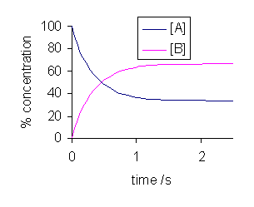
Direct and inverse reactions
Chemical reactions can occur in both directions (i.e. products are able to reform reactants) with rate constants k_{dir} and k_{inv}
with k_{dir} ≠ k_{inv}
The velocity of the direct and inverse reactions are defined as:
v_{dir} and v_{inv} can differ according to the composition of the starting mixture
When v_{dir} = v_{inv} there is no net change of concentrations [A], [B], [C], [D] with time: the system has reached the chemical equilibrium between reactants and products
Notes:
Many chemical reactions occur in both directions such that the products are able to re-form the reactants.
A dynamic equilibrium exists once a reversible reaction ceases to change its ratio of reactants/products, but substances move between the chemicals at an equal rate, meaning there is no net change. It is a particular example of a system in a steady state. In thermodynamics, a closed system is in thermodynamic equilibrium when reactions occur at such rates that the composition of the mixture does not change with time. Reactions do in fact occur, sometimes vigorously, but to such an extent that changes in composition cannot be observed.
The result is that equilibrium will be established between products and reactants.
In the example:
Equilibrium can be described by:
Note that all reactions have an equilibrium constant associated with them. In
the gas phase reaction:
The equilibrium constant is about 10140. Most gas phase reactions are like this,
that is, they are irreversible.
Basic

Slide 65
Chemical equilibrium
When a system is at chemical equilibrium it can remain in that state unless an external «perturbation» occurs (e.g. change in T, P, amount of reagents/products)
A system in chemical equilibrium is describe by an equilibrium constant K (dependent on T)
The equilibrium constant K defines the composition of the system at equilibrium:
Notes:
Many chemical reactions occur in both directions such that the products are able to re-form the reactants.
A dynamic equilibrium exists once a reversible reaction ceases to change its ratio of reactants/products, but substances move between the chemicals at an equal rate, meaning there is no net change. It is a particular example of a system in a steady state. In thermodynamics, a closed system is in thermodynamic equilibrium when reactions occur at such rates that the composition of the mixture does not change with time. Reactions do in fact occur, sometimes vigorously, but to such an extent that changes in composition cannot be observed.
The result is that equilibrium will be established between products and reactants.
In the example:
Equilibrium can be described by:
Note that all reactions have an equilibrium constant associated with them. In
the gas phase reaction:
The equilibrium constant is about 10140. Most gas phase reactions are like this,
that is, they are irreversible.
Basic

Slide 66
Chemical equilibrium
Example:
All reactions have an equilibrium constant associated with them, but in some cases it can be >>1 and the reaction can be considered irreversible.
Example:
Most gas phase reactions are irreversible
Notes:
Many chemical reactions occur in both directions such that the products are able to re-form the reactants.
A dynamic equilibrium exists once a reversible reaction ceases to change its ratio of reactants/products, but substances move between the chemicals at an equal rate, meaning there is no net change. It is a particular example of a system in a steady state. In thermodynamics, a closed system is in thermodynamic equilibrium when reactions occur at such rates that the composition of the mixture does not change with time. Reactions do in fact occur, sometimes vigorously, but to such an extent that changes in composition cannot be observed.
The result is that equilibrium will be established between products and reactants.
In the example:
Equilibrium can be described by:
Note that all reactions have an equilibrium constant associated with them. In
the gas phase reaction:
The equilibrium constant is about 10140. Most gas phase reactions are like this,
that is, they are irreversible.
Basic

Slide 67
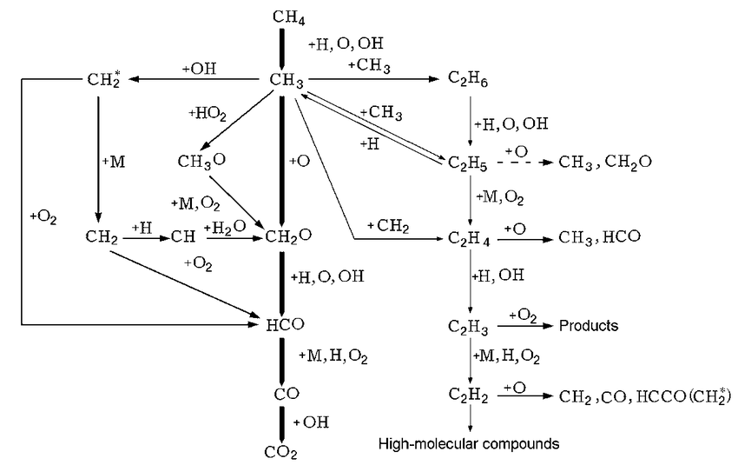
Reaction mechanisms for CH₄ combustion
One of the most famous mechanism for CH₄ combustion in air comprises 325 reactions and 53 species. It is proposed to model natural gas combustion, including NO_{x} formation
Simplified version: CH₄ combustion in pure O₂

Slide 68
Reaction mechanisms. Example 2
H_{2(g)} + Br_{2(g)} → 2 HBr_{(g)}
Possible mechanism:
Br₂ + M → 2Br + M k_{1dir}
2Br + M → Br₂ + M k_{1inv}
Br + H₂ → HBr + H k₂ slow
H + Br₂ → HBr + Br k₃ fast
fast equilibrium

Slide 69
Reaction mechanisms. Example 2
The slowest state determines the global velocity of the reaction (rate determining step)
Br + H₂ → HBr + H k₂
Br₂ ⇔ 2Br k₁

Slide 70
Multi-step complex reactions 1.
‘complex reaction’ (in kinetics) = a reaction whose mechanism comprises more than one elementary step
The overall atmospheric chemistry can be seen as a complex reaction case, where a rather complex scheme of elementary reactions (hundreds), which are linked among them (either in in sequence – consecutive - or parallel - competitive) can account for the observed abundances of the various species.
An example:
NO• + O₃ → NO₂• + O₂ v₁=k₁[NO][O₃]
2) O• + O₂ +M → O₃ + M v₂=k₂[O][O₂][M]
3) NO₂• + hν → NO• + O• v₃=j [NO₂]
4) NO₂• + O• → NO• + O₂ v₄=k₃ [NO₂][O]

Slide 71
Multi-step complex reactions 2.
NO• + O₃ → NO₂• + O₂ v₁=k₁[NO][O₃]
2) O• + O₂ +M → O₃ + M v₂=k₂[O][O₂][M]
3) NO₂• + hν → NO• + O• v₃=j [NO₂]
4) NO₂• + O• → NO• + O₂ v₄=k₃ [NO₂][O]
Time derivatives of [NO], [NO₂],[O] and [O₃]:
Since [O₂] is not affected by reactions (1)-(4), no expression for its rate of change is needed. Same for [M]

Slide 72
Multi-step complex reactions 3.
A set of 4 coupled differential equations:
The rate equations for virtually all complex reaction mechanisms generally comprise a complicated system of coupled differential equations that cannot be solved analytically.
And so? What do we do?
1. In state-of-the-art kinetic modelling studies, fairly sophisticated software is generally used to obtain numerical solutions to the rate equations in order to determine the time-varying concentrations of all species involved in a reaction sequence

Slide 73
Multi-step complex reactions 4.
And so? What do we do?
2. In most cases very good approximate solutions may often be obtained by making simple assumptions
e.g.: steady steate approx on [O₃]
Reduced by 1 the dimentionality
3. Limit to the most important reactions: low rate coefficients and low reactant concentrations render a reaction unimportant

Slide 74
Exercise n. 9 - Kinetics
The rate constants for the reactions of propene (C₃H₆) with OH, O₃, and NO₃ at 1 atm pressure and 298 K are 2.6x10⁻¹¹, 1.0x10⁻¹⁷, and 9.5x10⁻¹⁵ cm³⋅molecule⁻¹s⁻¹, respectively. Typical concentrations at the surface in a moderately polluted atmosphere are [OH]=5x10⁶ molecule⋅cm⁻³, [O₃]=100 ppb, and [NO₃]=50 ppt. Assume 298 K and 1 atm pressure.
What are the half-lives of propene with respect to removal from the atmosphere by each of these species?
What is the half-life of propene with respect to all three acting simultaneously?

Slide 75
Exercise n. 9 - Kinetics
C₃H₆ + OH → products k_{OH}= 2.6x10⁻¹¹ cm³⋅molecule⁻¹s⁻¹
C₃H₆ + O₃ → products k_{O3}= 1.0x10⁻¹⁷ cm³⋅molecule⁻¹s⁻¹
C₃H₆ + NO₃ → products k_{NO3}= 9.5x10⁻¹⁵ cm³⋅molecule⁻¹s⁻¹
Concentrations: [OH]=5x10⁶ molecule⋅cm⁻³
[O₃]=100 ppb [NO₃]=50 ppt T=298 K, P= 1 atm
Solution
a) We apply the pseudo-first order expression for the half-life: t_{1/2}=ln2/k[B]=0.693/k[B]
But first we need to express mixing ratios (ppb and ppt) in term of number density. Given the number density of air at 298 K and 1 atm:
100 ppb=0.1ppm=10⁻⁷x2.463x10¹⁹ =2.463x10¹² molecule⋅cm⁻³ [O₃]
50 ppt=2.463x10¹⁹x50/10¹²=1.23x10⁹ molecule⋅cm⁻³ [NO₃]

Slide 76
Exercise n. 9 - Kinetics
C₃H₆ + OH → products k₁= 2.6x10⁻¹¹ cm³⋅molecule⁻¹s⁻¹
C₃H₆ + O₃ → products k₂= 1.0x10⁻¹⁷ cm³⋅molecule⁻¹s⁻¹
C₃H₆ + NO₃ → products k₃= 9.5x10⁻¹⁵ cm³⋅molecule⁻¹s⁻¹
Concentrations: [OH]=5x10⁶ molecule⋅cm⁻³
[O₃]=100 ppb [NO₃]=50 ppt T=298 K, P= 1 atm
Solution
100 ppb=0.1ppm=2.463x10¹² molecule⋅cm⁻³ for O₃
50 ppt=2.463x10¹⁹x50/10¹²=1.23x10⁹ molecule⋅cm⁻³ for NO₃
t_{1/2 OH}=0.693/k_{OH}[OH] = 0.693 /(2.6x10⁻¹¹⋅ 5x10⁶)
cm⁻³⋅molecule⋅s/molecule⋅cm⁻³ =5.33x10³s = 1.481 h
t_{1/2 O3}=0.693/k[O3]=0.693/(1.0x10⁻¹⁷⋅2.463x10¹²)
cm⁻³⋅molecule⋅s/molecule⋅cm⁻³ = 2.814x10⁴ s = 7.82 h
t_{1/2 NO3}=0.693/k[NO3]=0.693/(9.5x10⁻¹⁵⋅1.23x10⁹)
cm⁻³⋅molecule⋅s/molecule⋅cm⁻³ = 5.93x10⁴ s = 16.47 h
b) 1/t_{1/2 tot}=1/t_{1/2 OH}+1/t_{1/2 O3} +1/t_{1/2 NO3}=
1/ 1.481 +1/7.82 +1/16.47 =0.8638
Hence t_{1/2 tot}= 1/0.8638 = 1.16 h

Slide 77
Exercise n. 10 - Kinetics
Consider the following reaction mechanism:
A₂ + B₂ → R + C (slow) ; A₂ + R → C (fast)
Write the overall balanced chemical equation.
Identify any intermediates within the mechanism.
What is the order with respect to each reactant?

Slide 78
Exercise n. 10 - Kinetics
Consider the following reaction mechanism:
A₂ + B₂ → R + C (slow) ; A₂ + R → C (fast):
Write the overall balanced chemical equation.
Identify any intermediates within the mechanism.
What is the order with respect to each reactant?
Solution
By summing the two elementary steps we get:
2A₂ + B₂ → 2C;
b) R is the reaction intermediate;
c) since the first step is the slow one, the overall reaction rate will be given by the first process that is 1st order in A₂ and 1st order in B₂, so v=k₁[A₂]⋅[B₂]

Slide 79
Exercise n. 11 - Kinetics
Consider the following chain mechanism:
      A₂ → A• + A• k₁
      A• → B• + C k₂ (slowest step)
      A• + P → B• k₃
      A• + B• → P k₄
Use the steady state approximation to determine the rate law for the overall reaction

Slide 80
Exercise n. 11 - Kinetics
Consider the following chain mechanism:
      A₂ → A• + A• k₁
      A• → B• + C k₂ (slowest step)
      A• + P → B• k₃
      A• + B• → P k₄
Use the steady state approximation to determine the rate law for the overall reaction
Solution The rate for consumption of A₂ can be written as:
The steady state approximation can be used on P:
Then the steady state approximation can be used on A• :
This could be used, for instance, to determine the rate law of the overall reaction assuming that the slowest step is (2). In this case:

Slide 81
Exercise n. 11 - Kinetics
Solution (cont)
This could be used to determine the rate law of the overall reaction, given by the slowest step (2) :

